Slide 1
WebQuiz Prototype
Work in progress…
Green arrows indicate where you should click to continue with the prototype. If there are more than one arrows then you can click either.

Slide 2
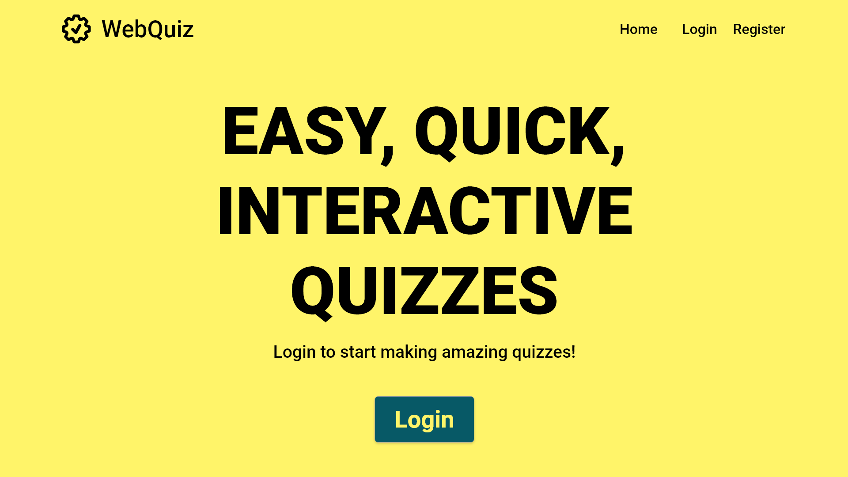
If the Quiz Maintainer does not have an account, one can be registered here

Slide 3
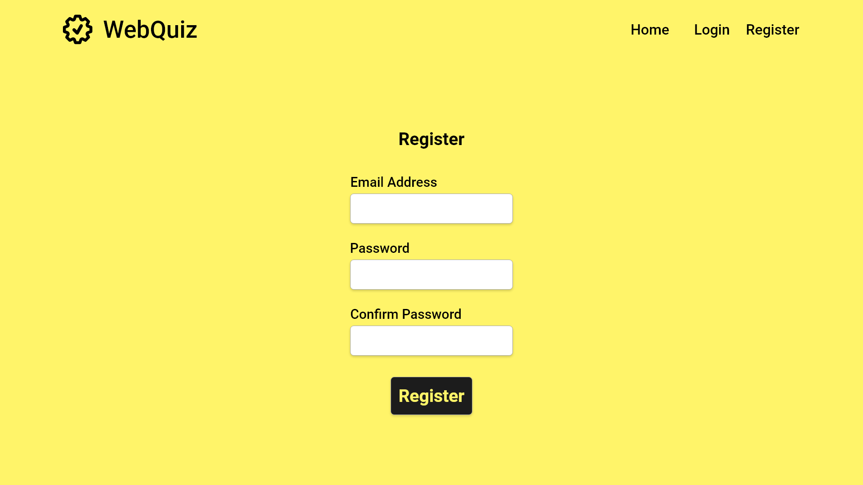
User fills in both text boxes
Start Register
Click the button once forms are filled
Error case

Slide 4
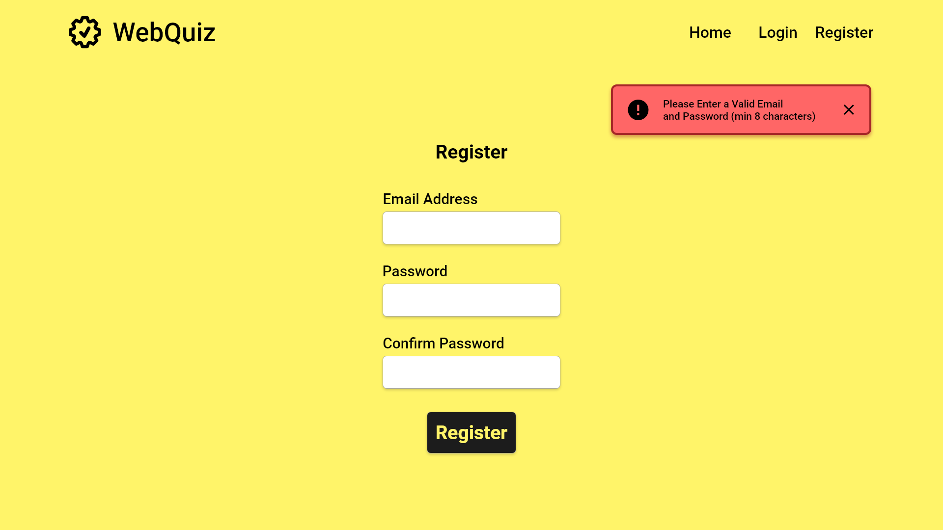
An error message will be returned if either box is left blank
User fills in both text boxes
Click the button once forms are filled

Slide 5
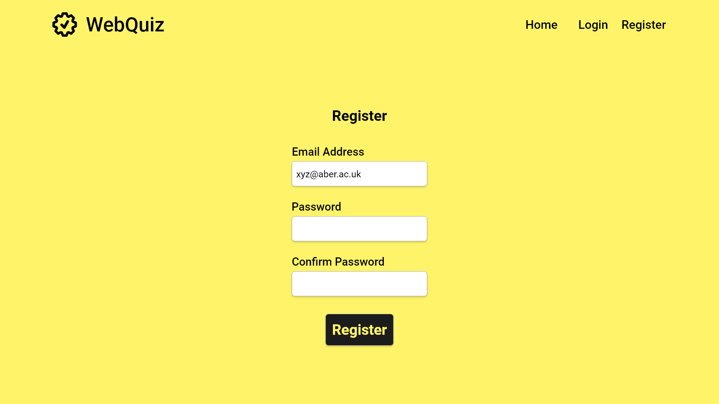

Slide 6
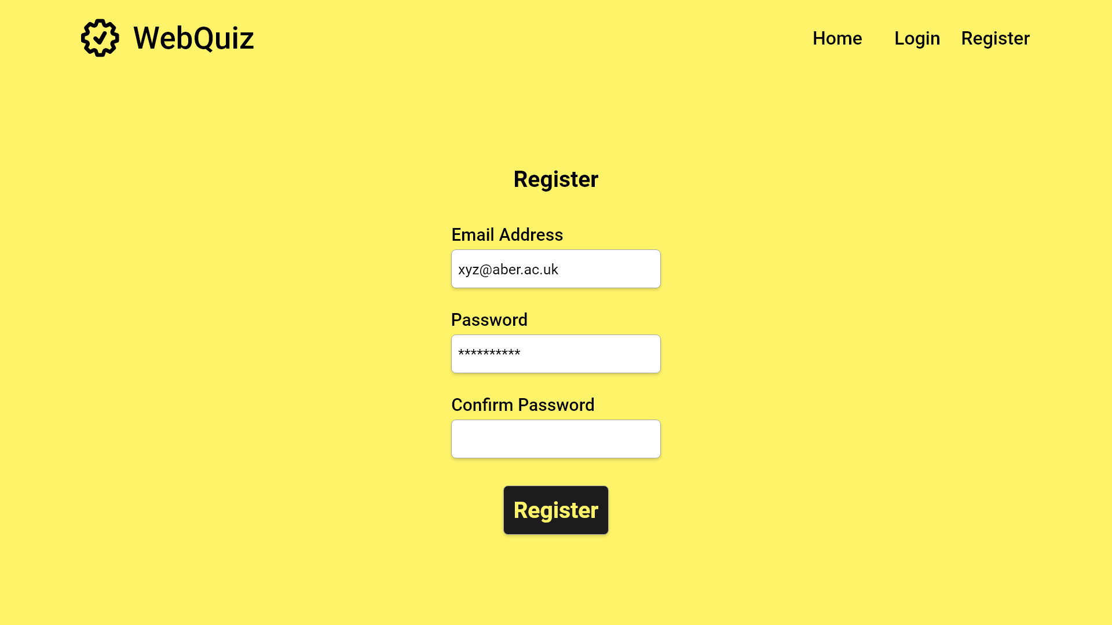

Slide 7


Slide 9
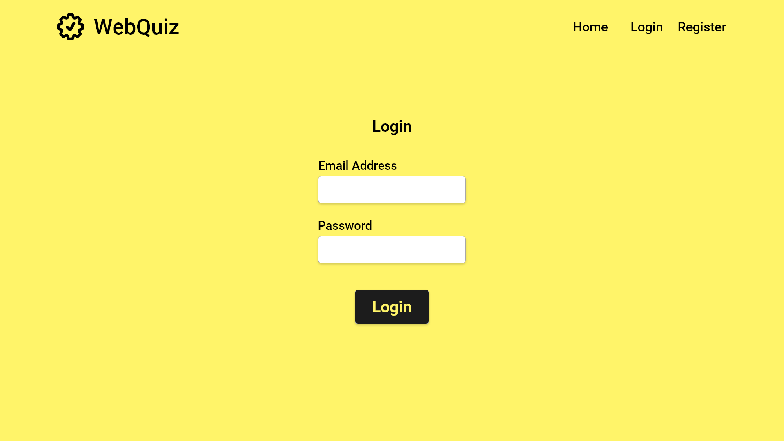
Error Case

Slide 10
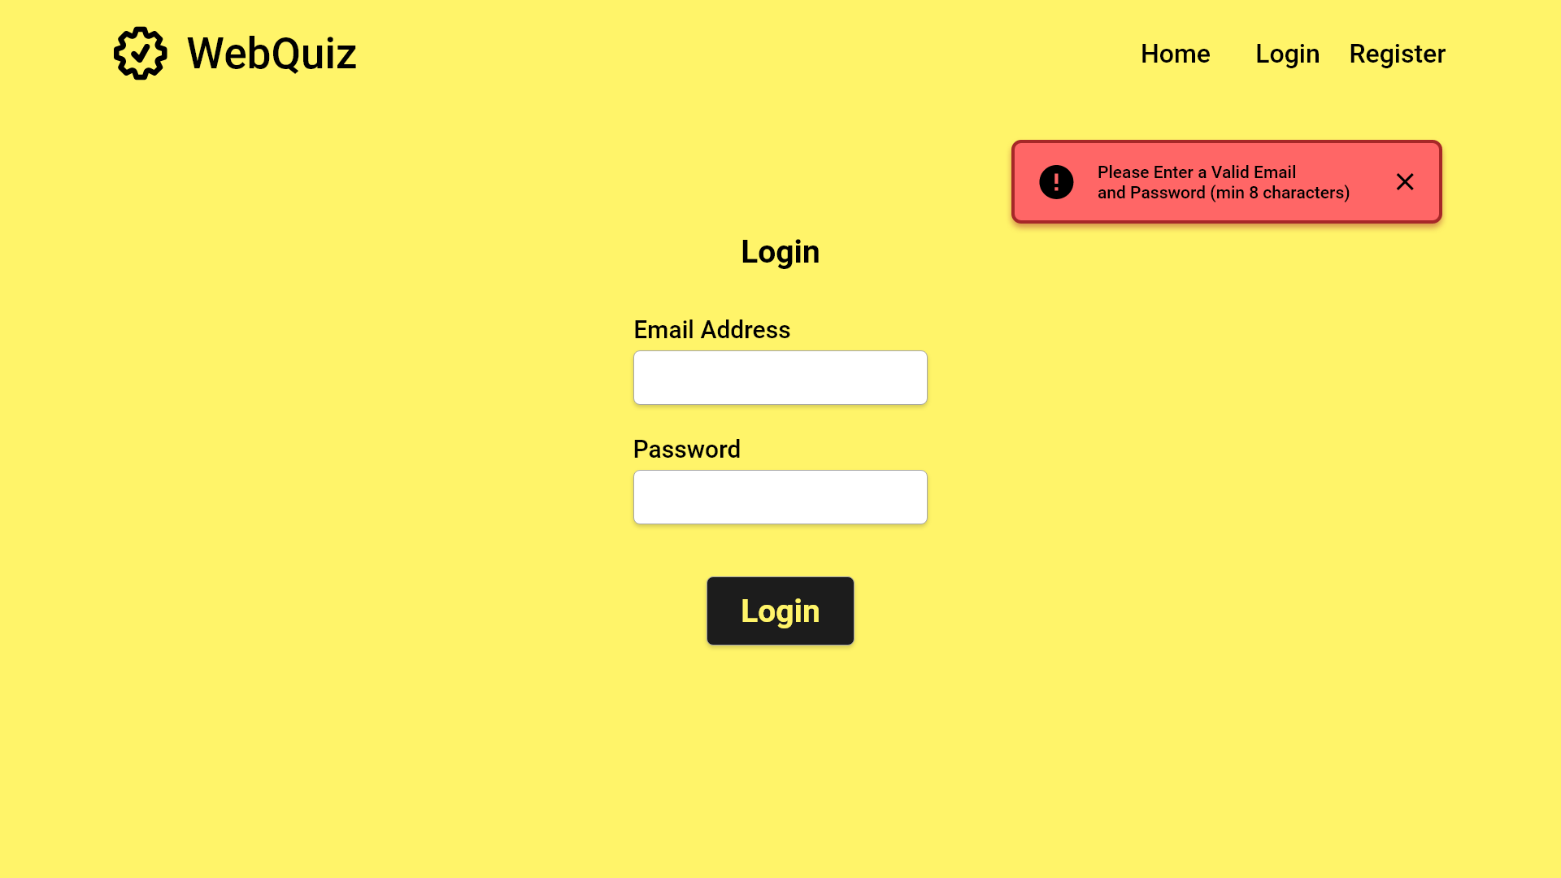

Slide 12


Slide 13
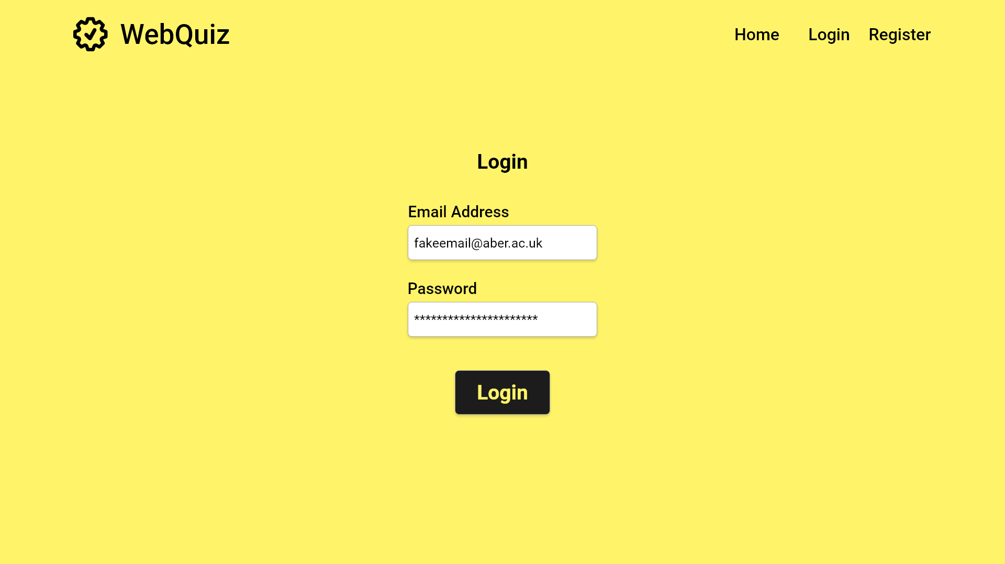

Slide 14
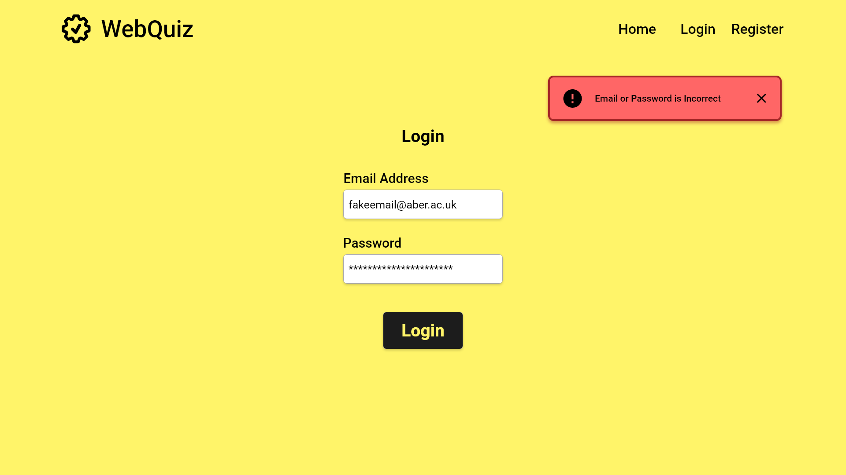

Slide 16
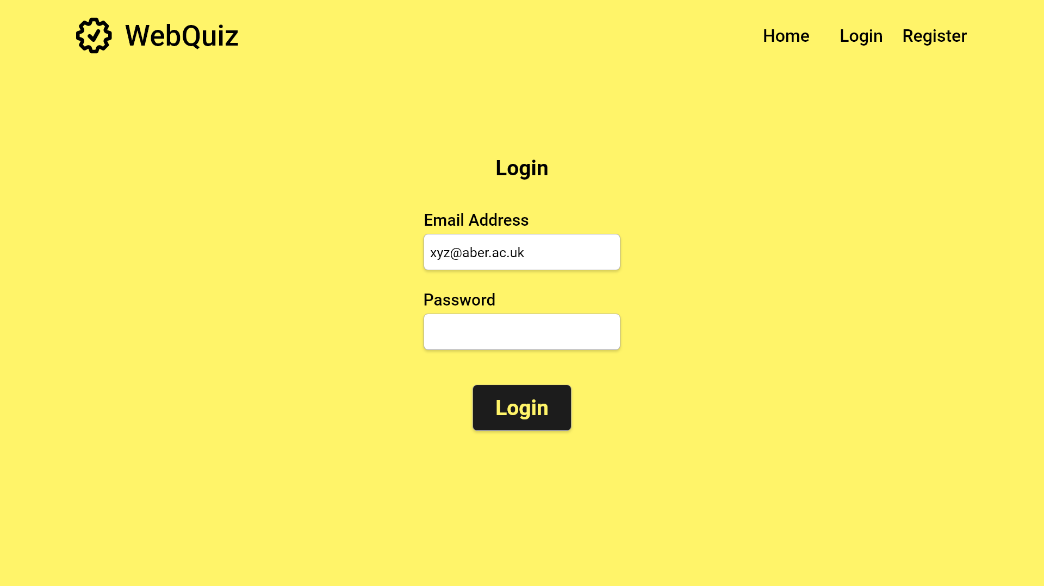

Slide 17
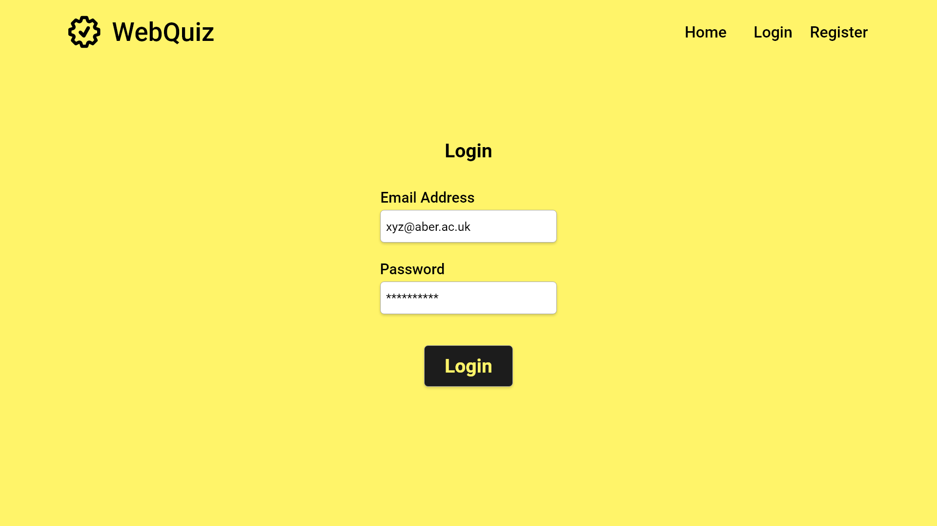

Slide 18
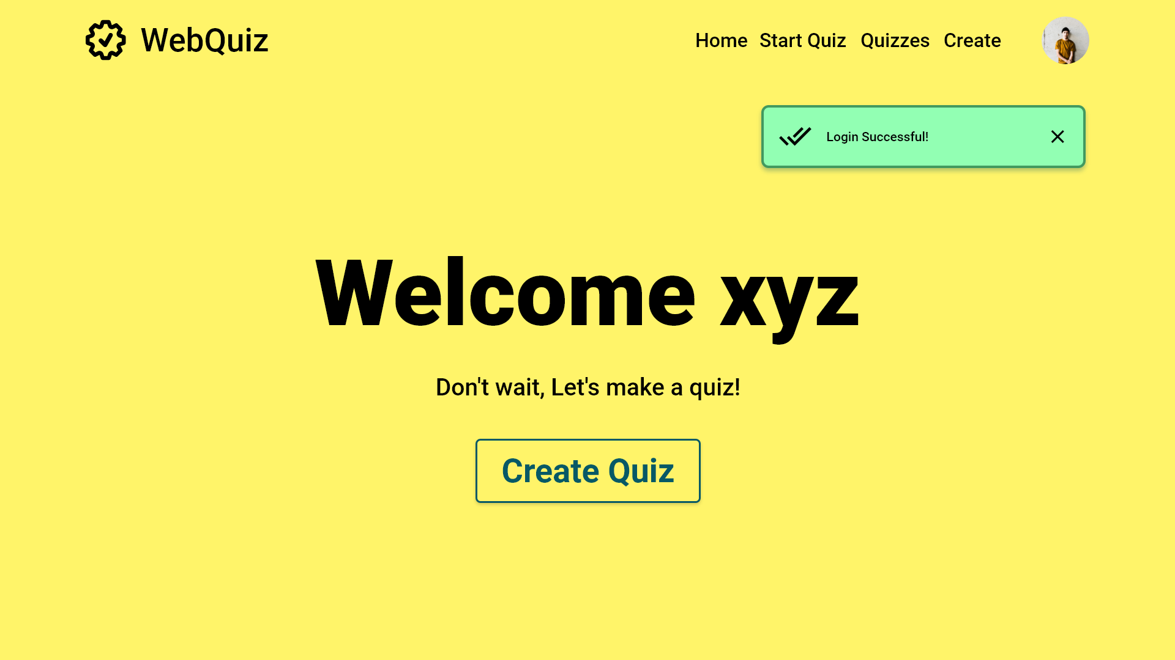
Close success message
Start Quiz Creation

Slide 19
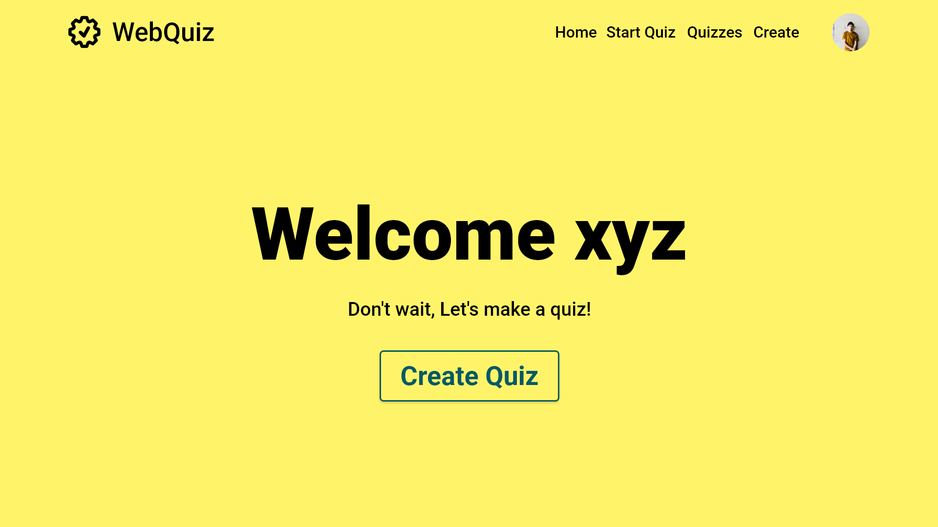
Start Quiz Creation
Start Quiz Creation

Slide 20
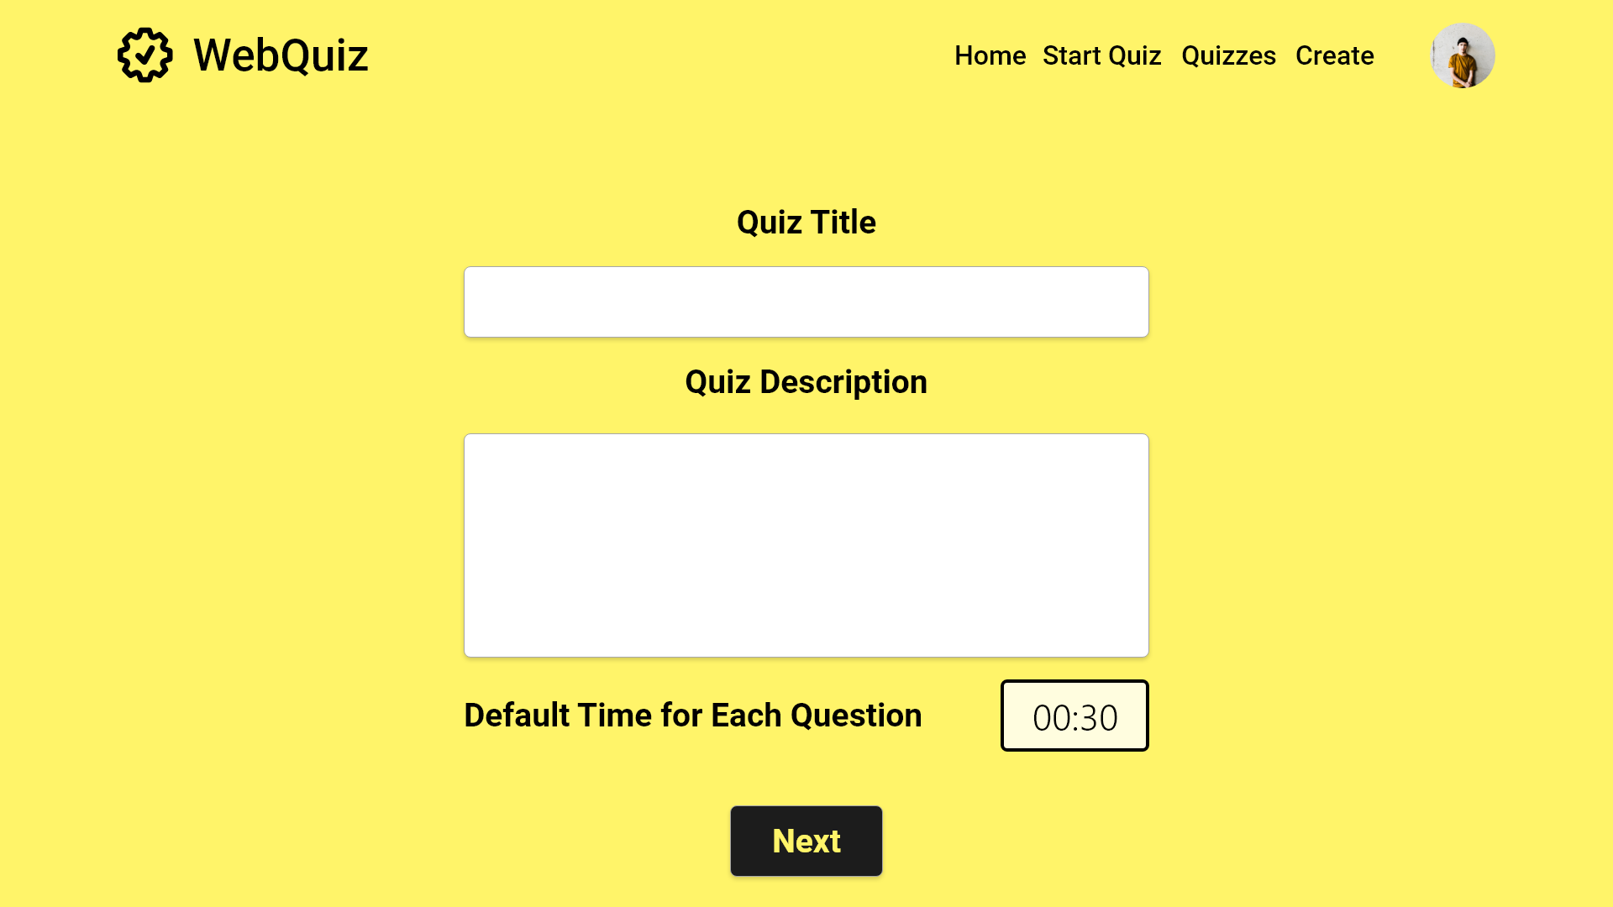

Slide 21
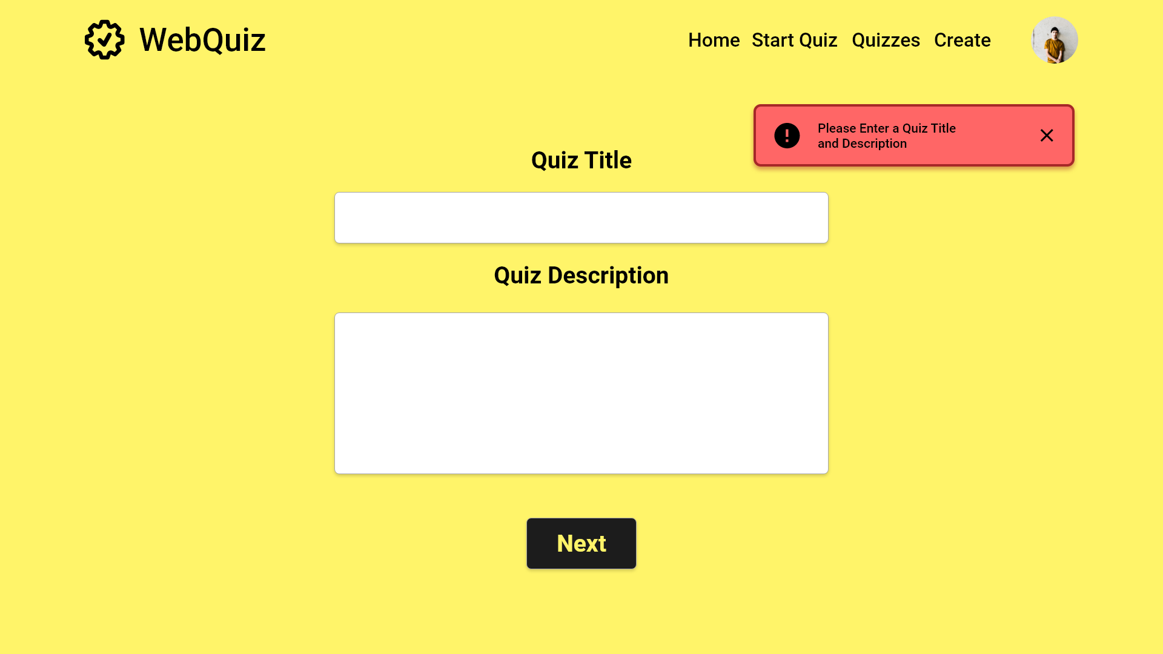
Close error message

Slide 22
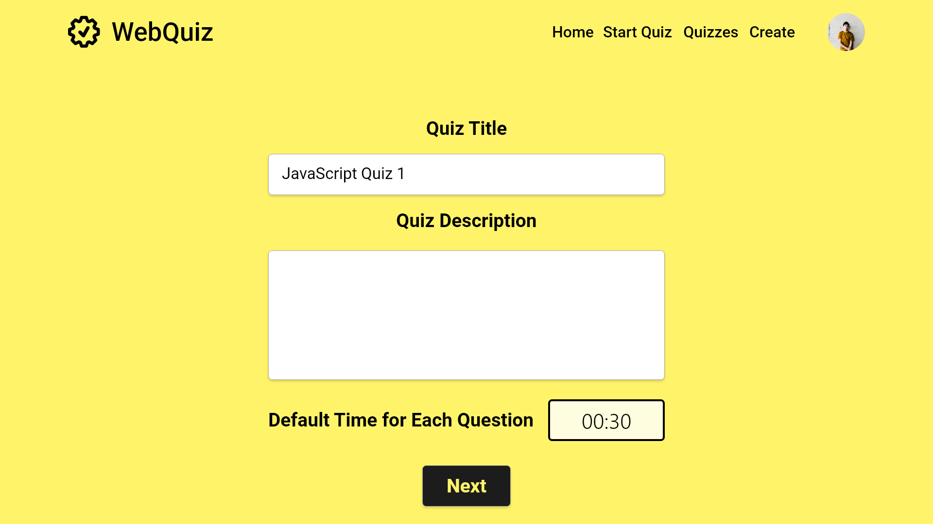

Slide 23
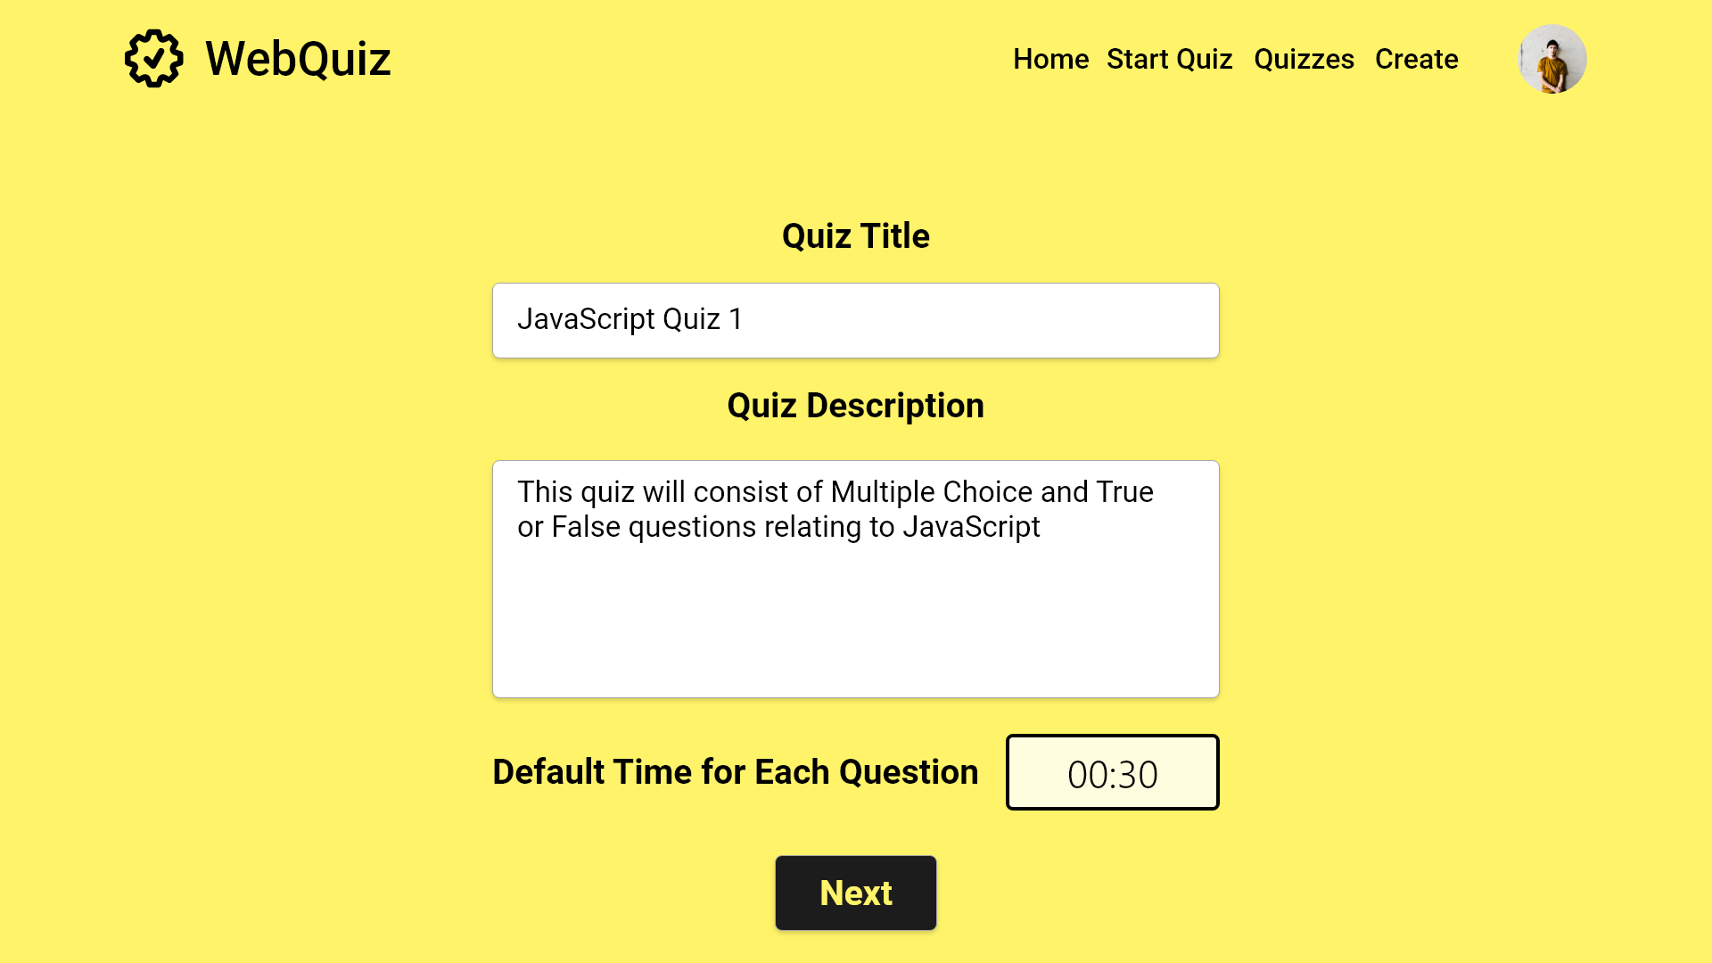

Slide 24
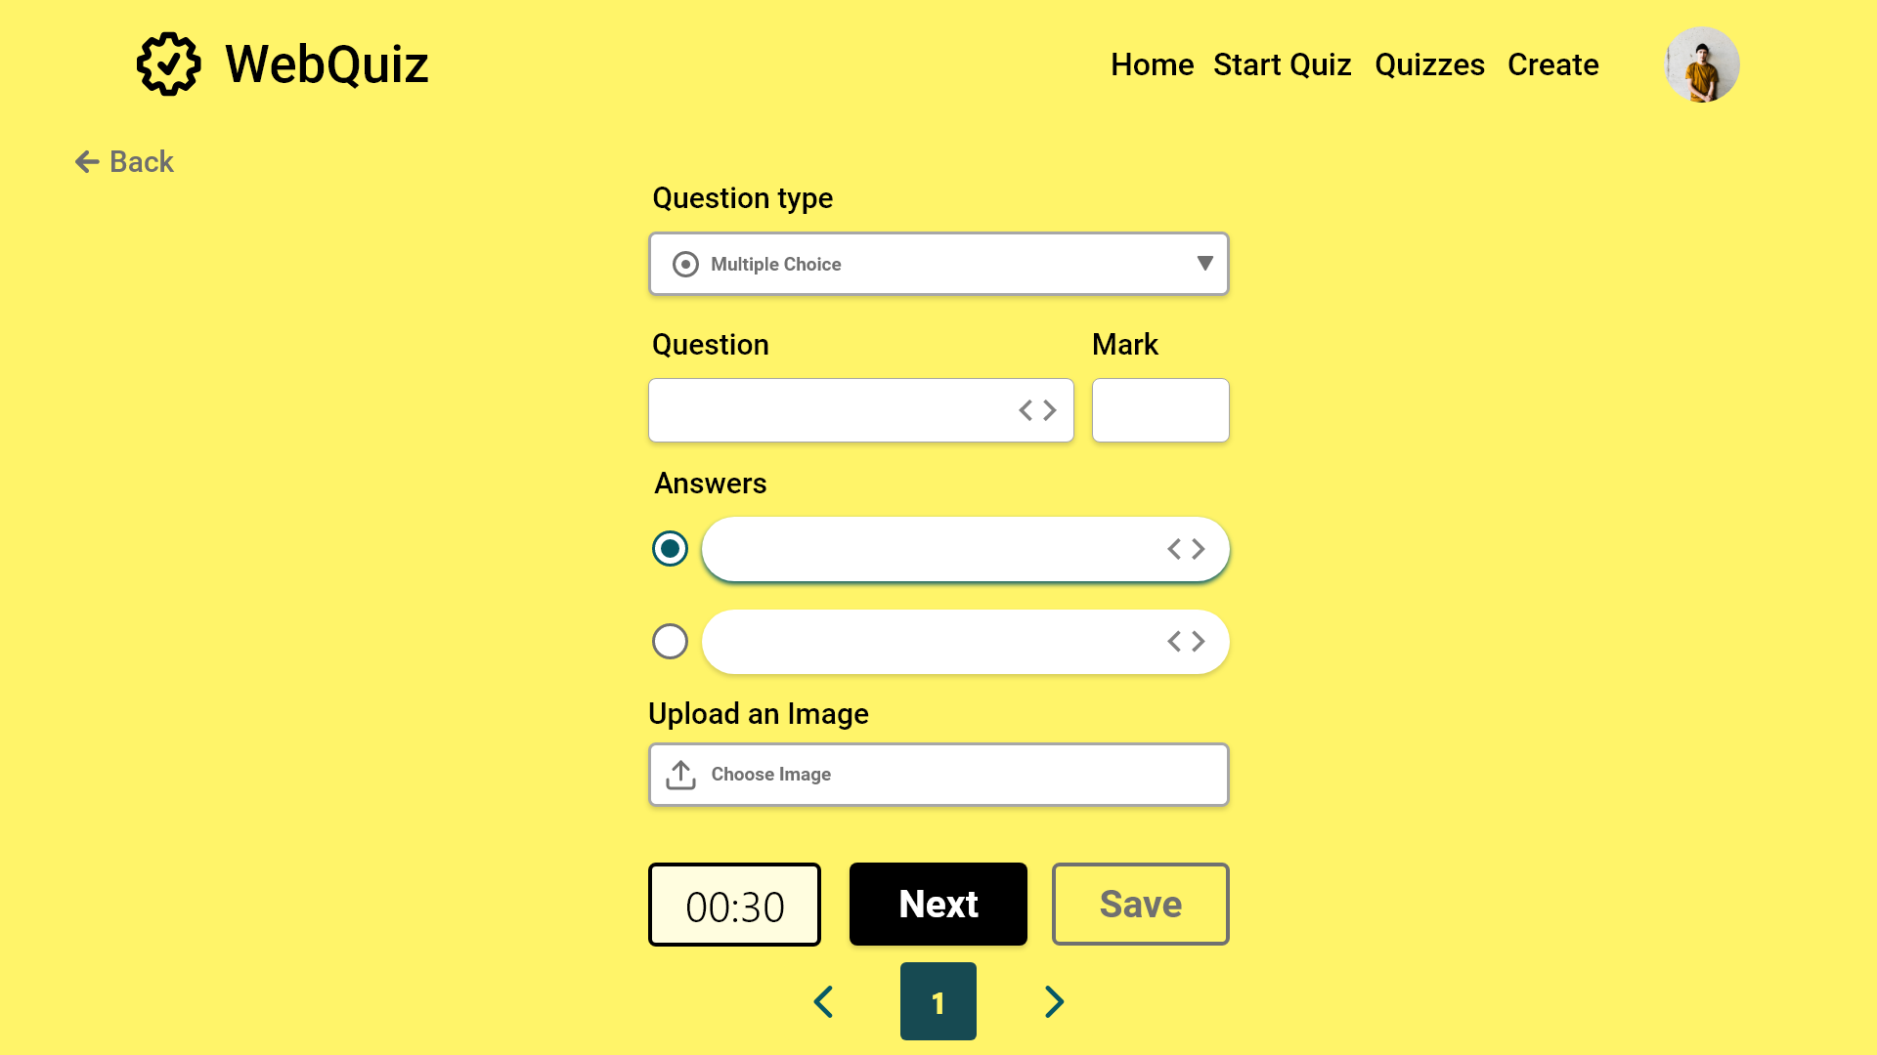
Error case

Slide 25
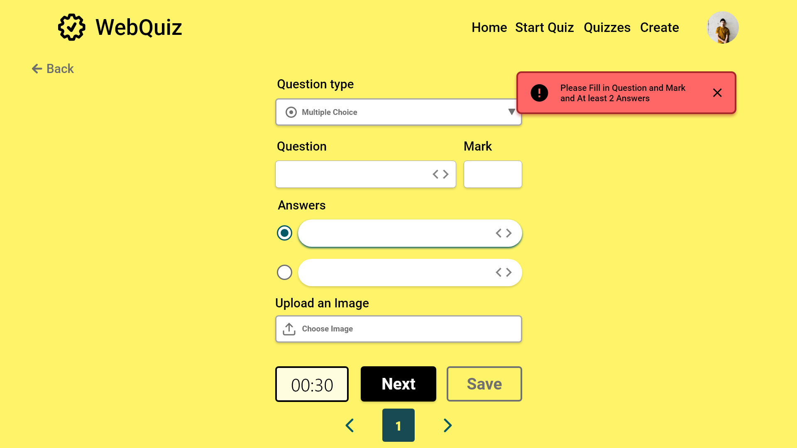

Slide 26
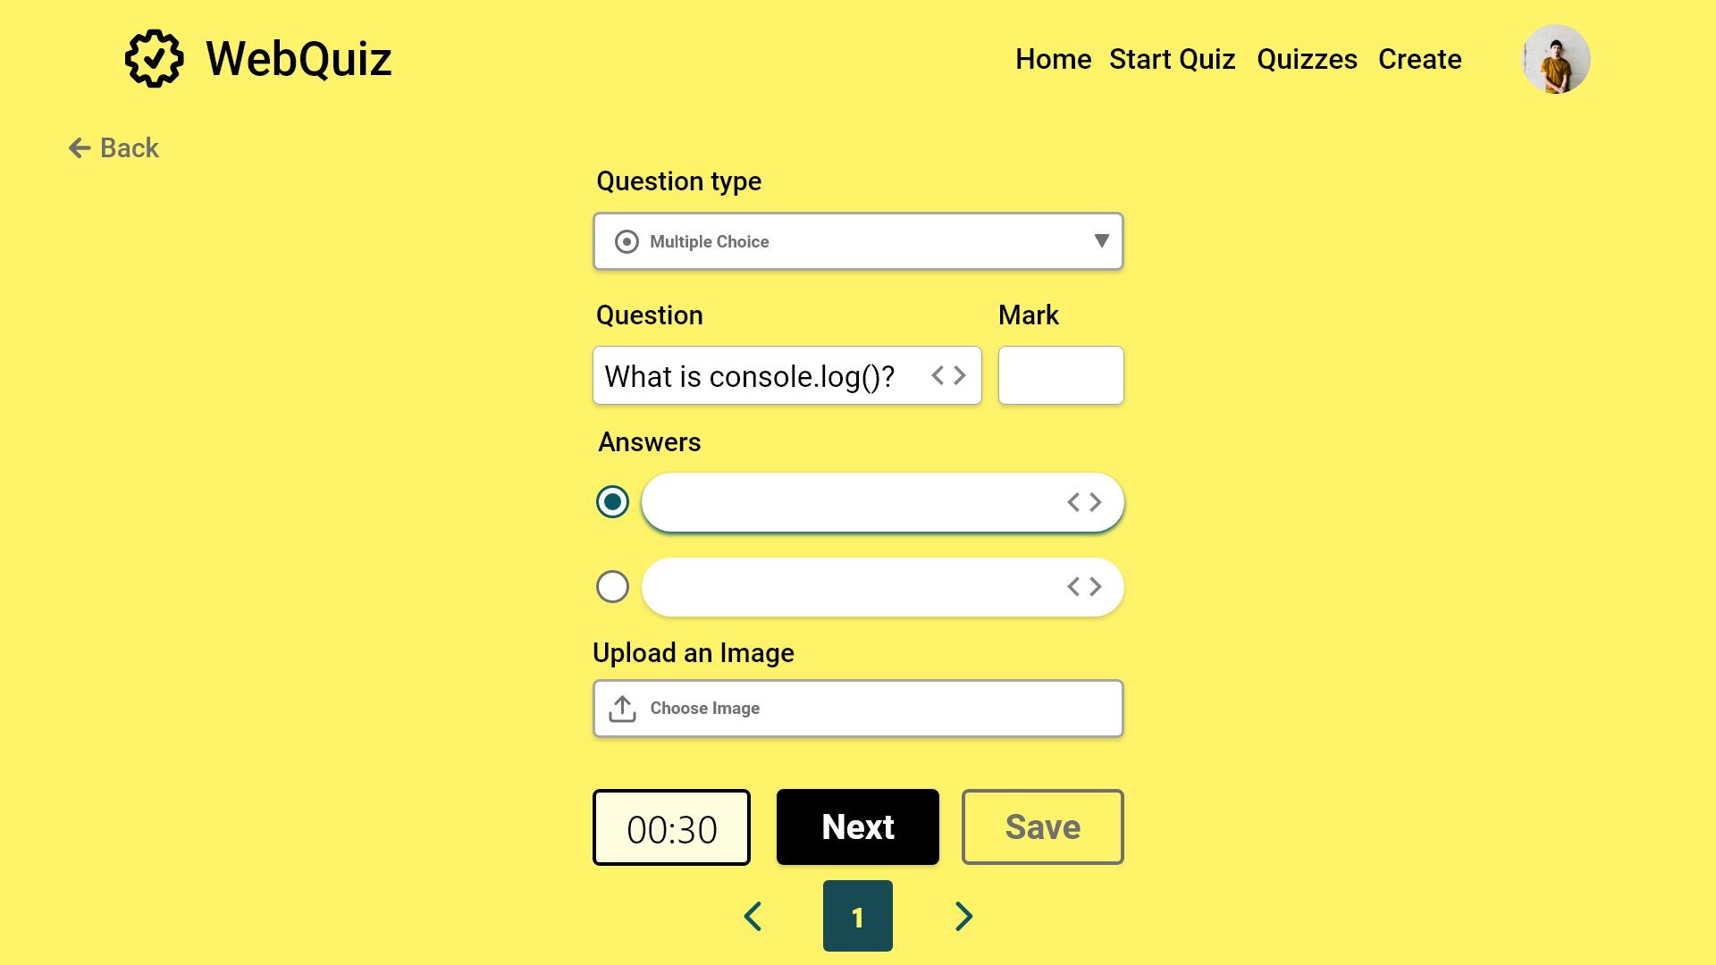

Slide 27


Slide 28
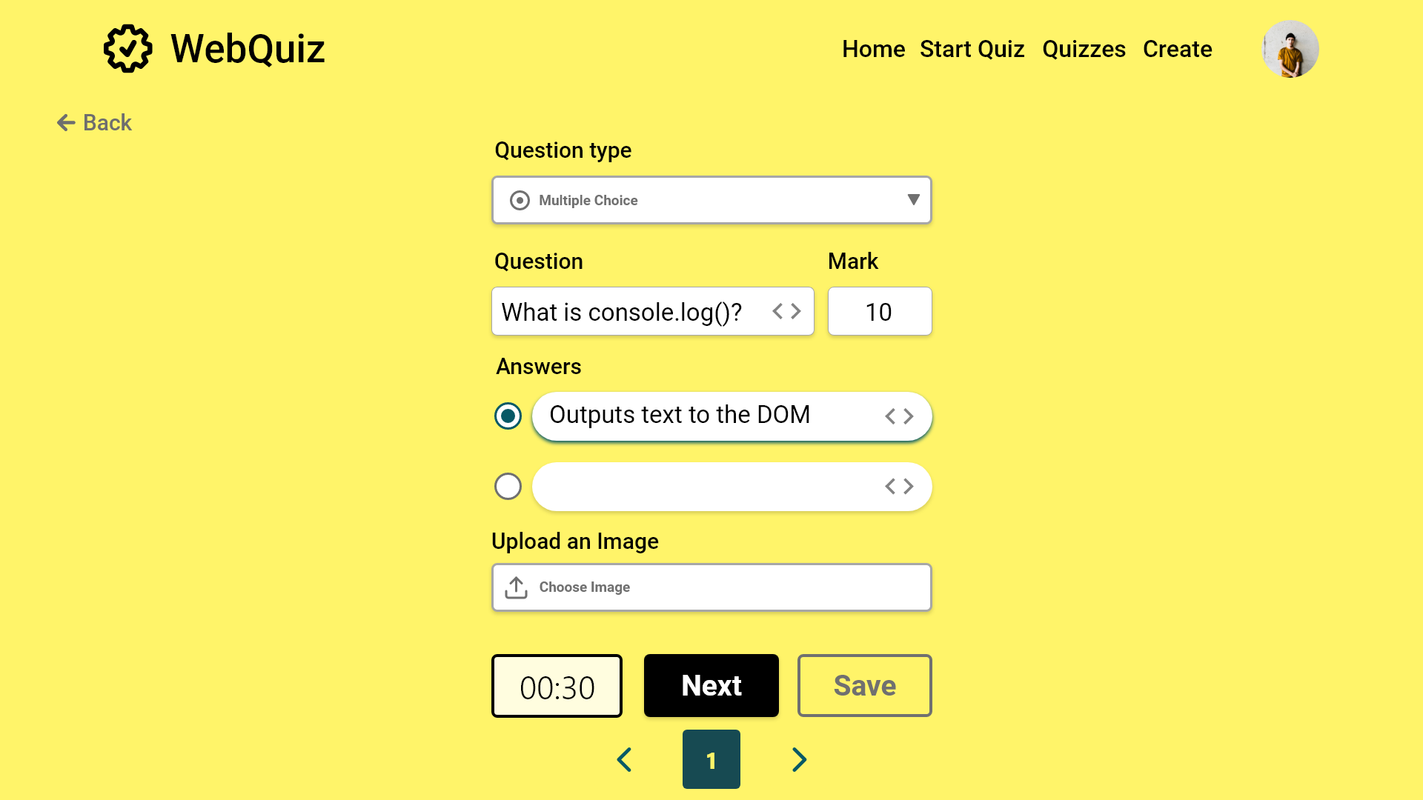

Slide 29
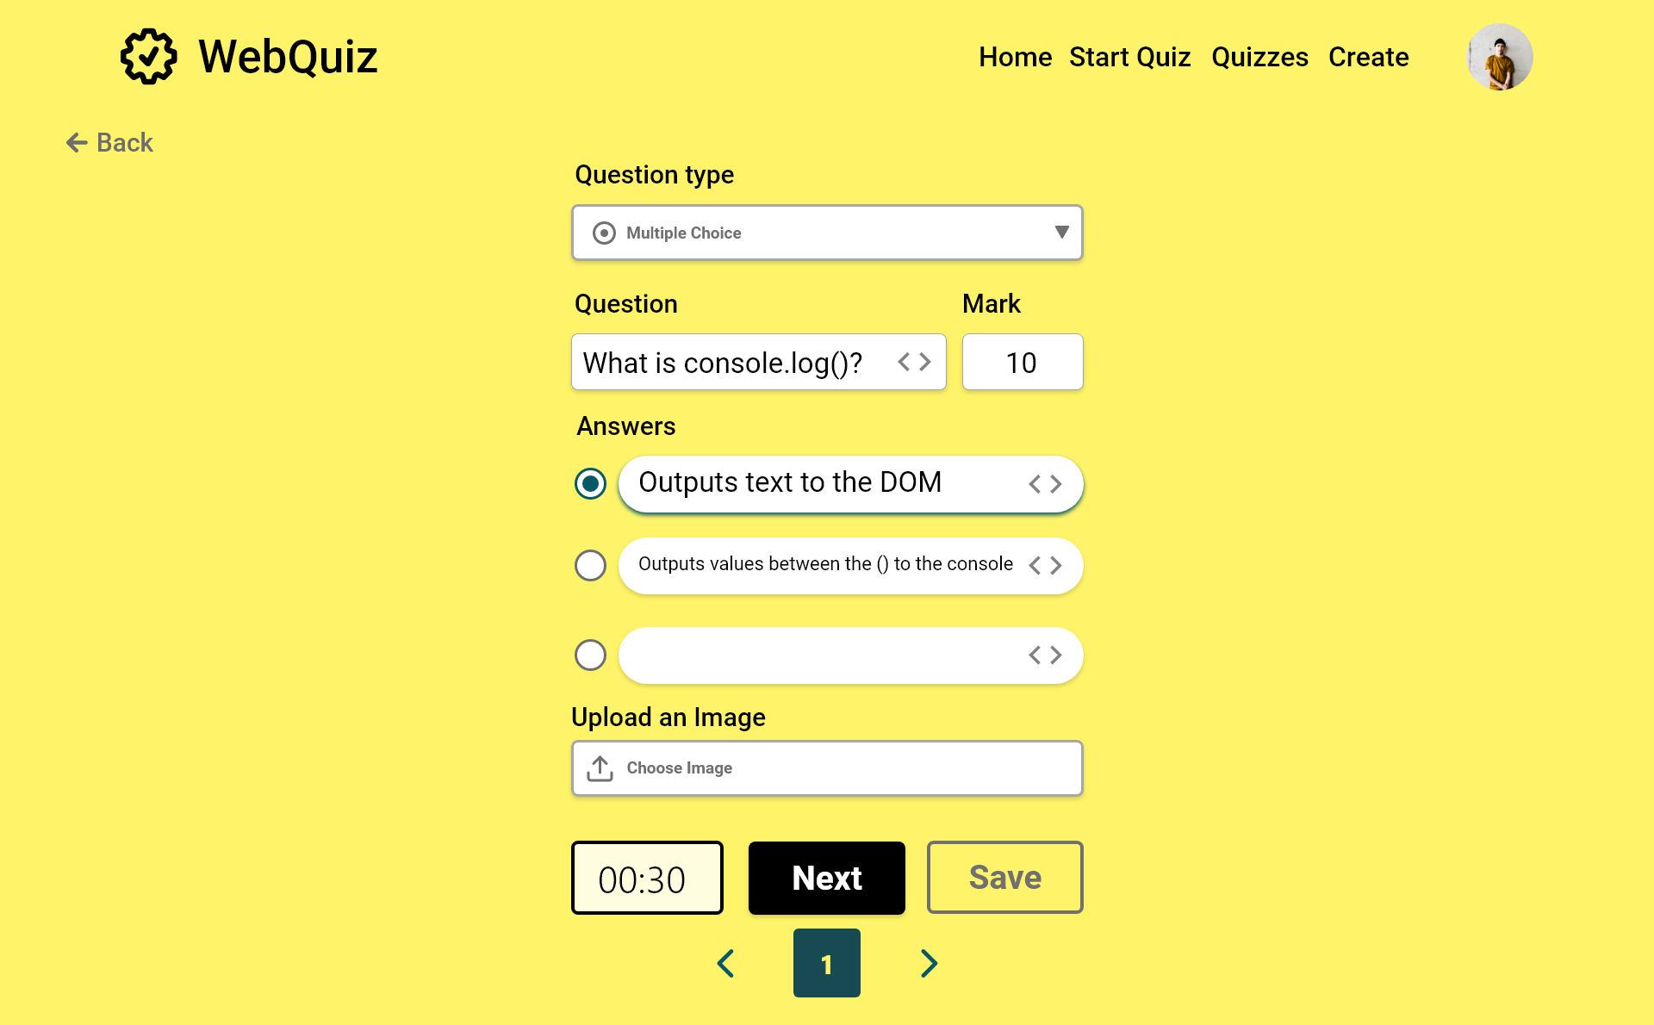

Slide 30
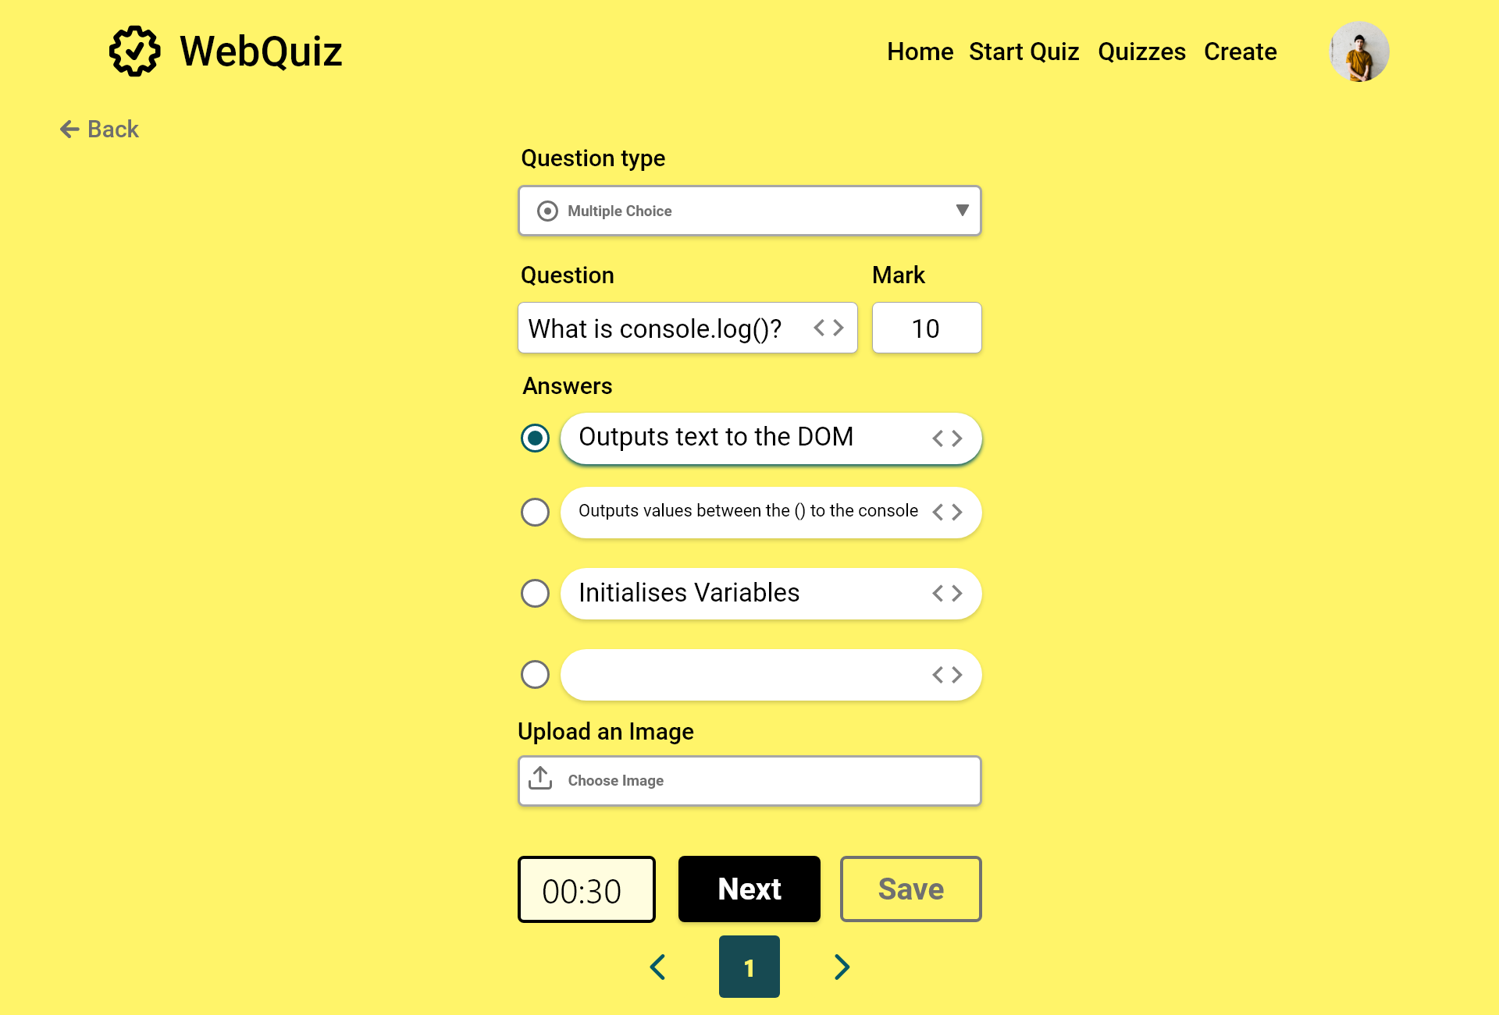

Slide 31
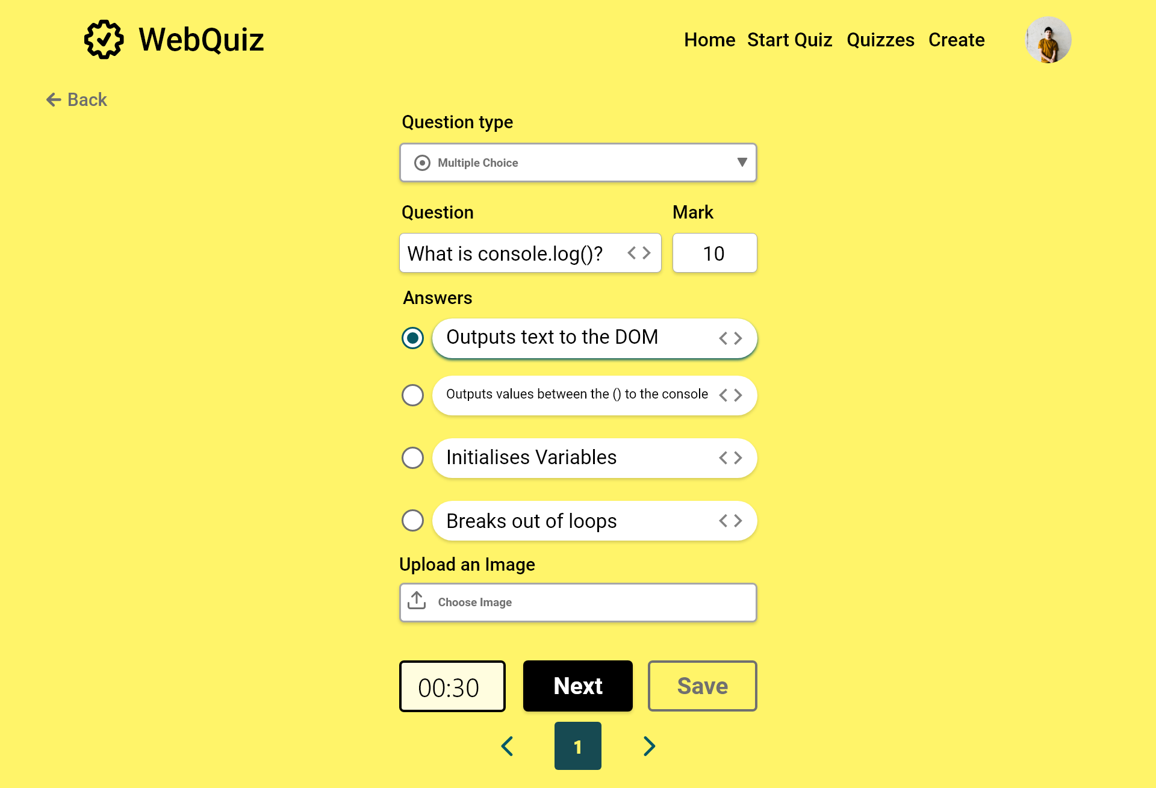

Slide 32
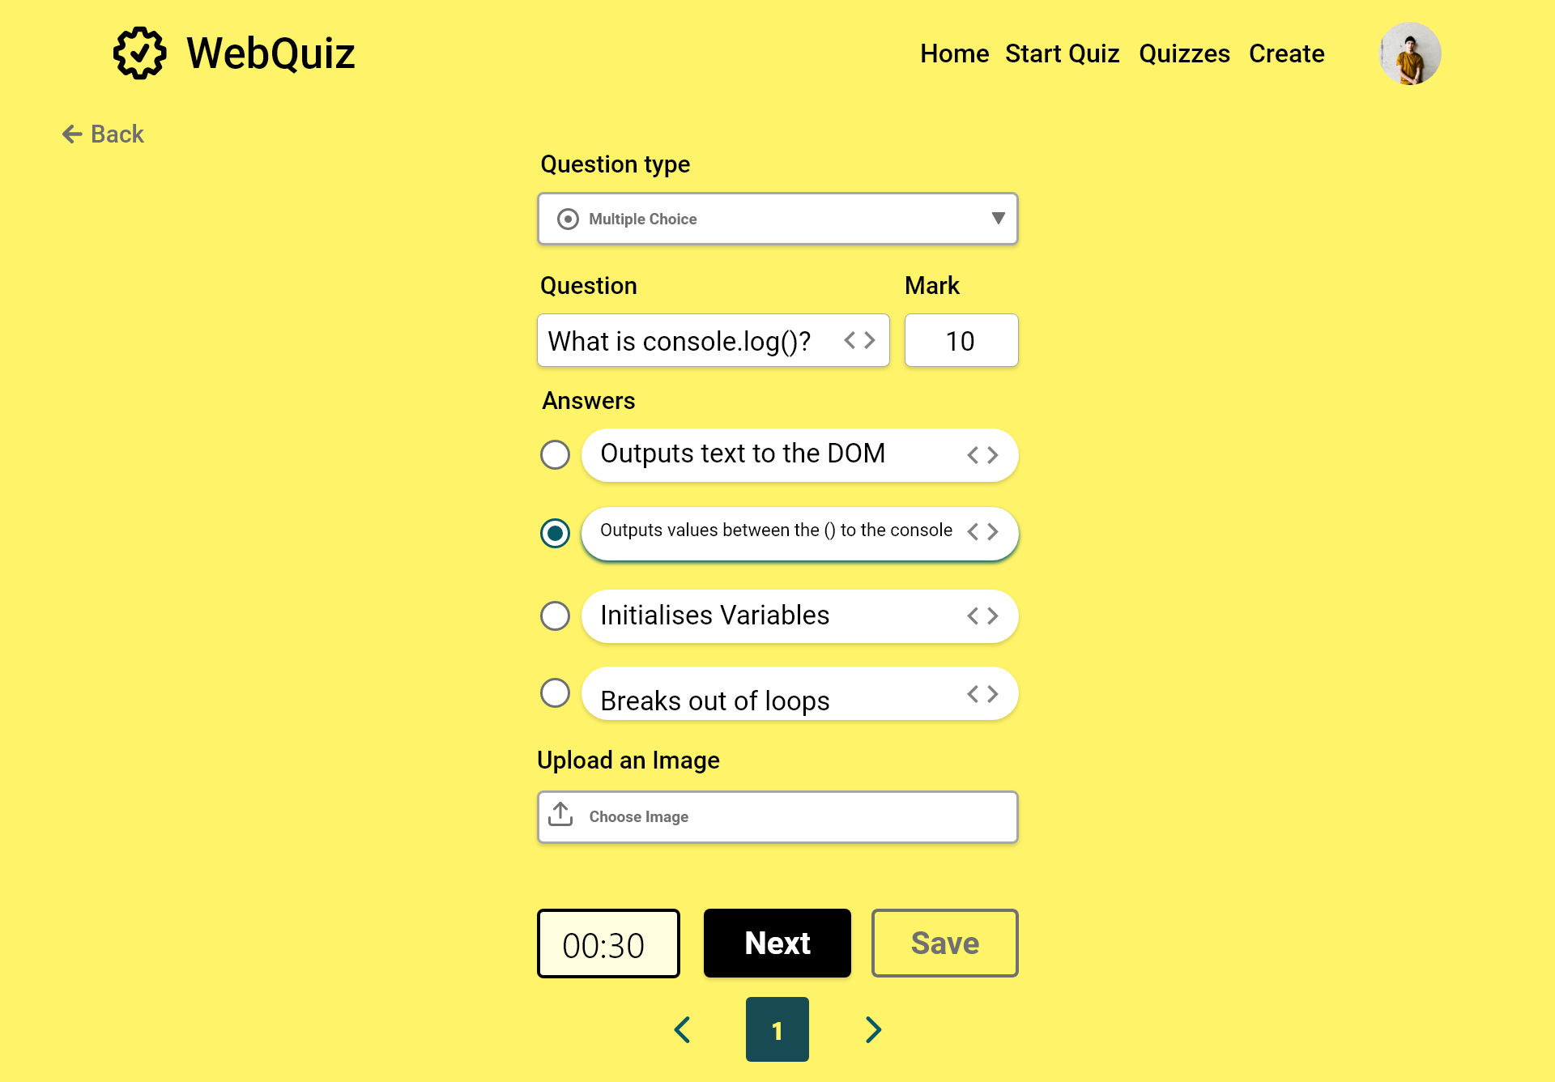

Slide 33
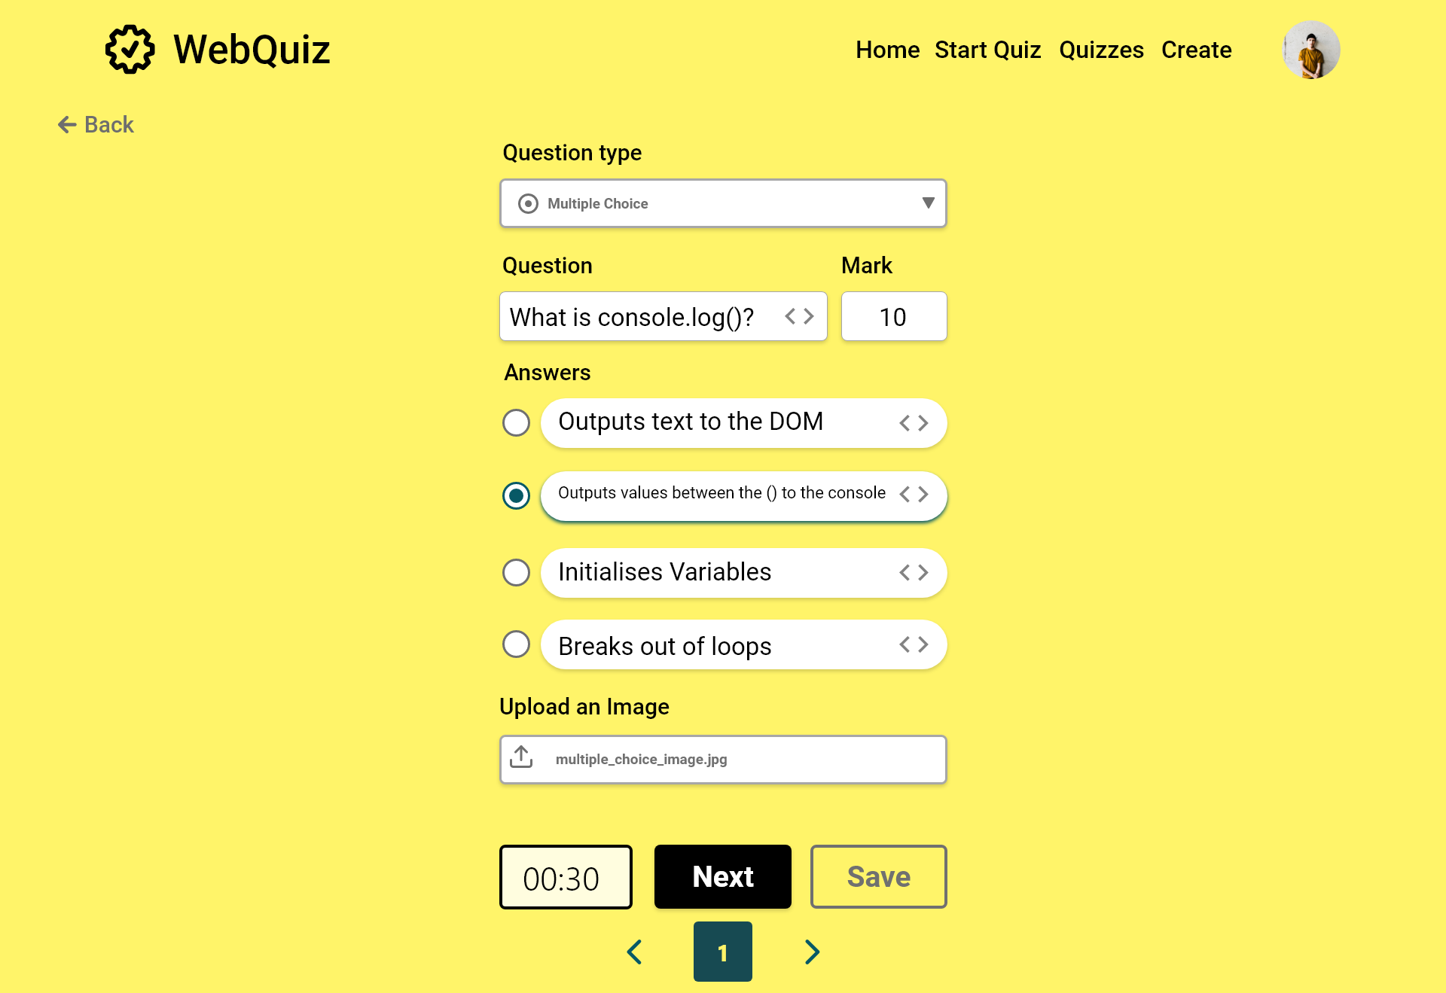

Slide 34


Slide 35
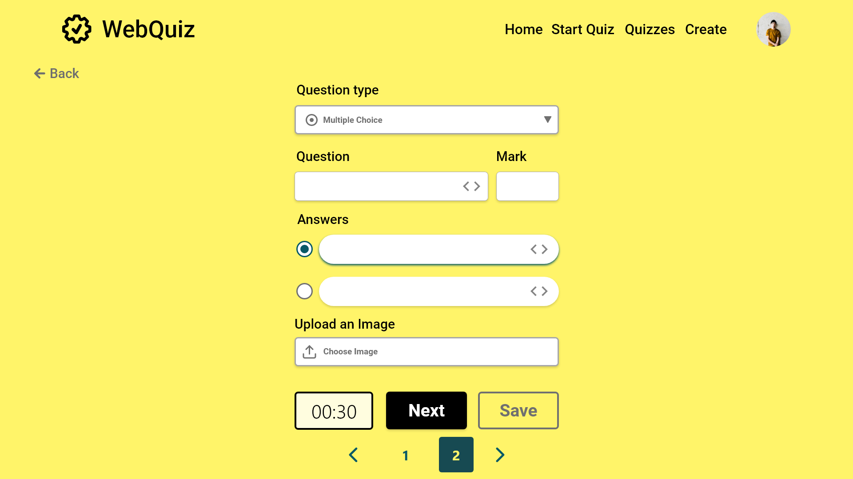

Slide 36
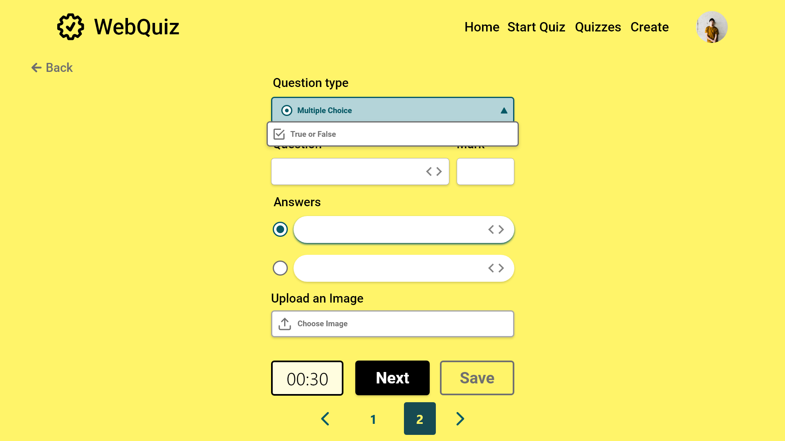

Slide 37
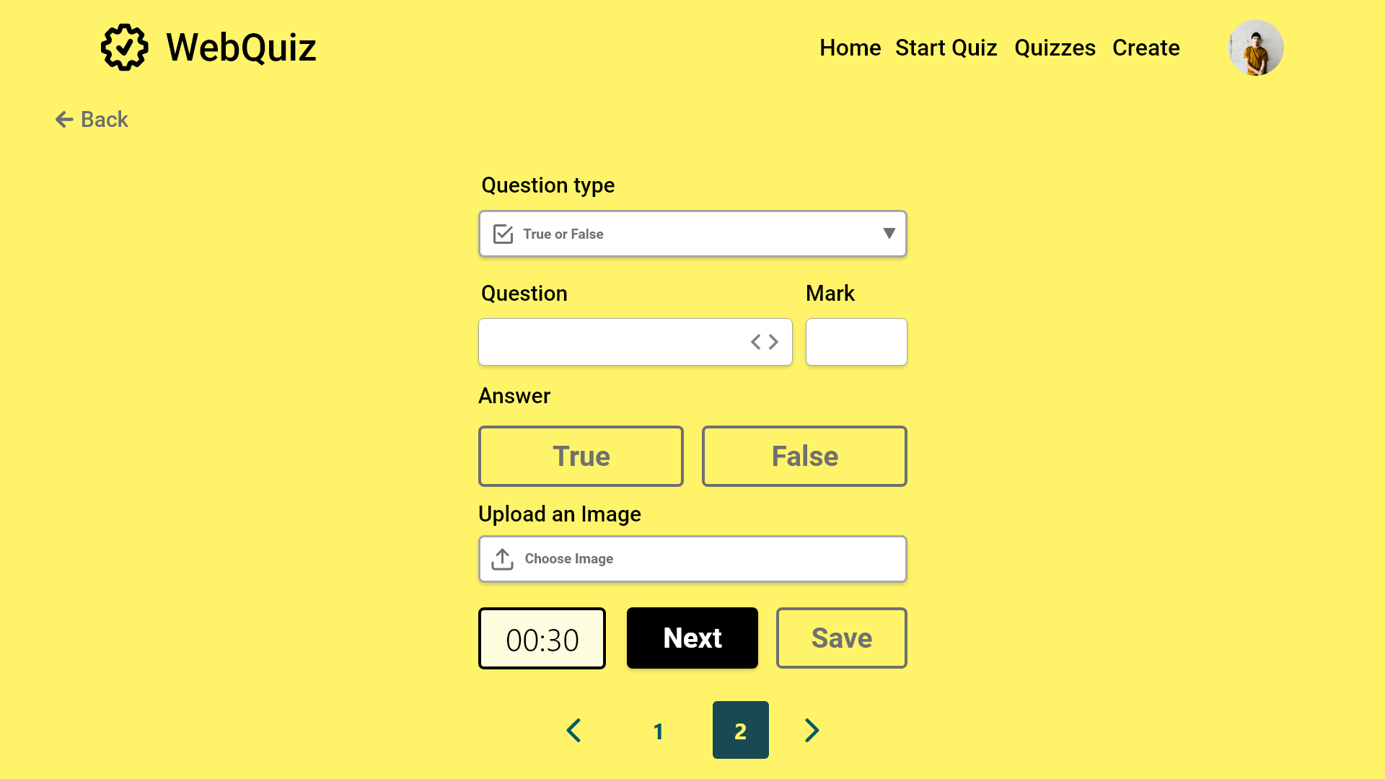
Error case

Slide 38
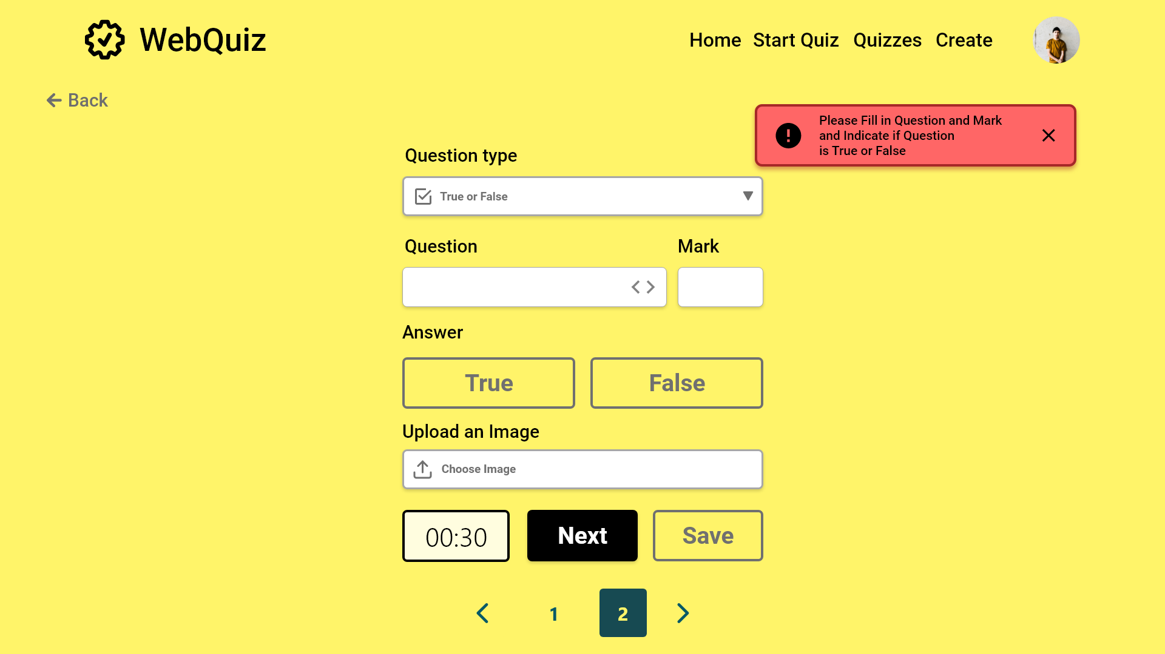

Slide 39
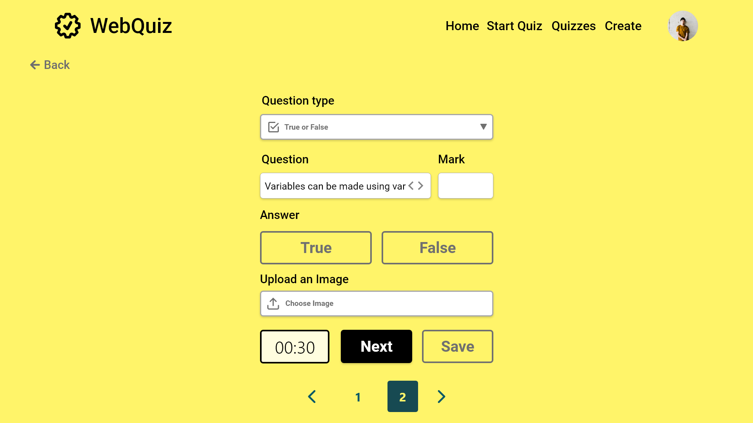

Slide 40
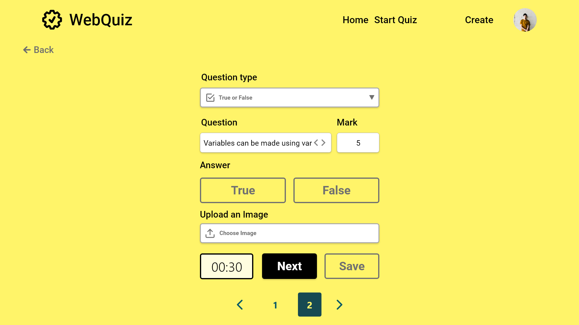


Slide 41
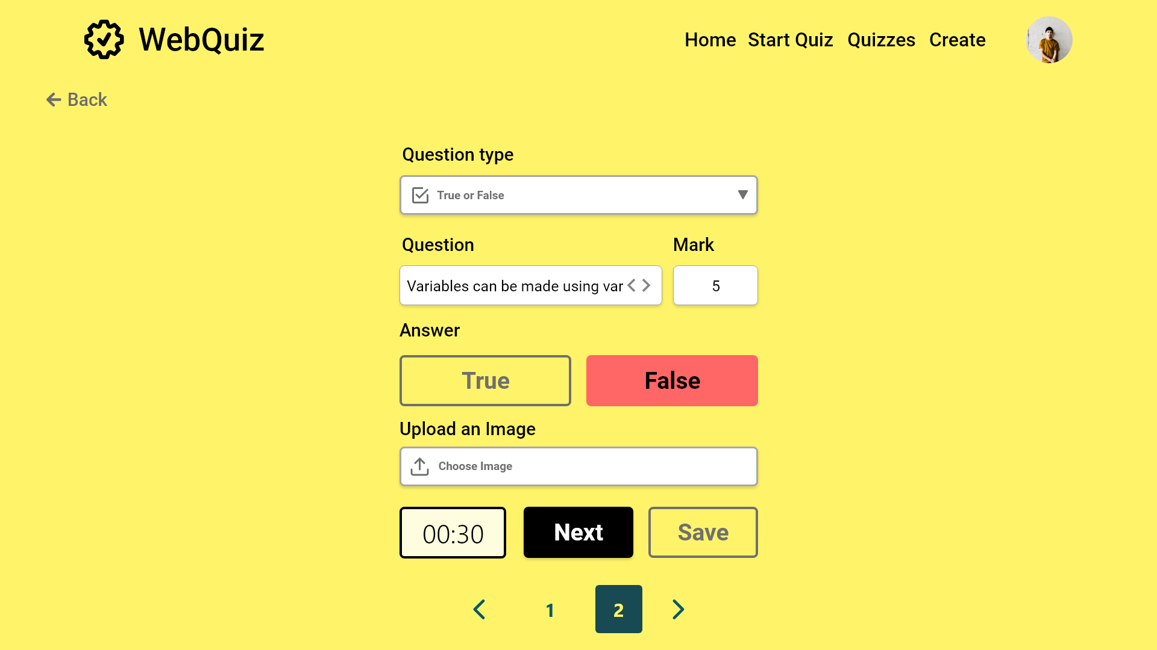

Slide 42
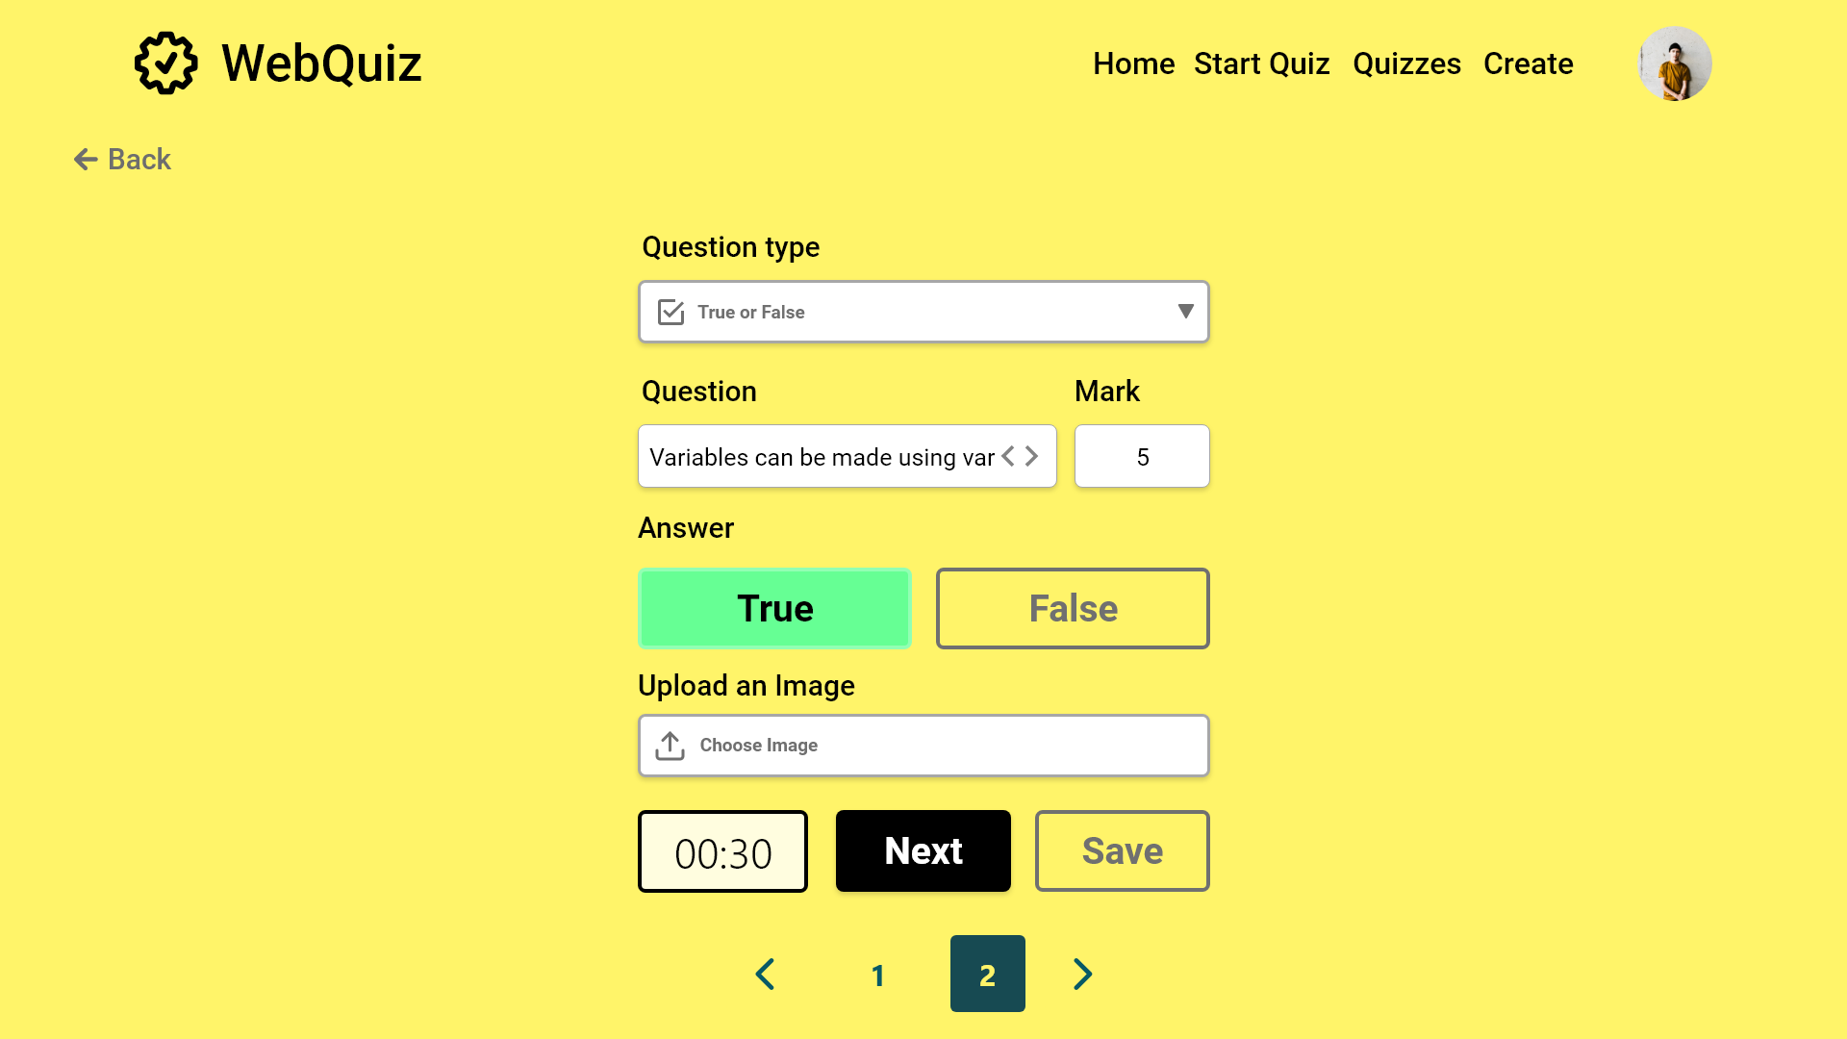

Slide 43


Slide 44


Slide 45
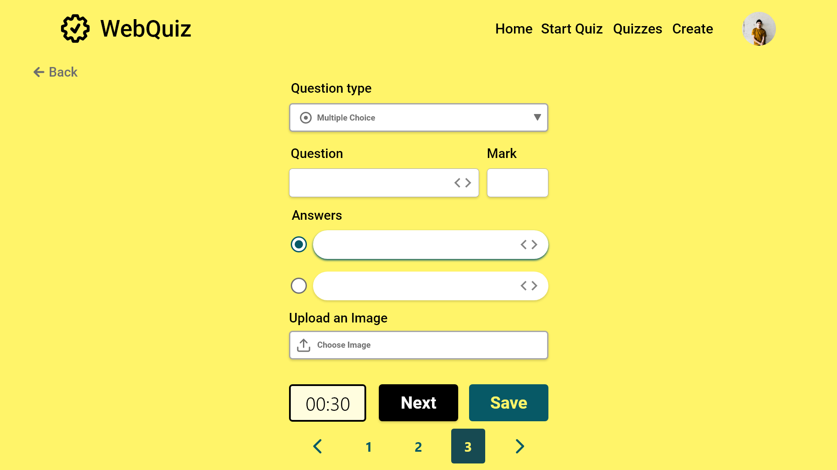

Slide 46
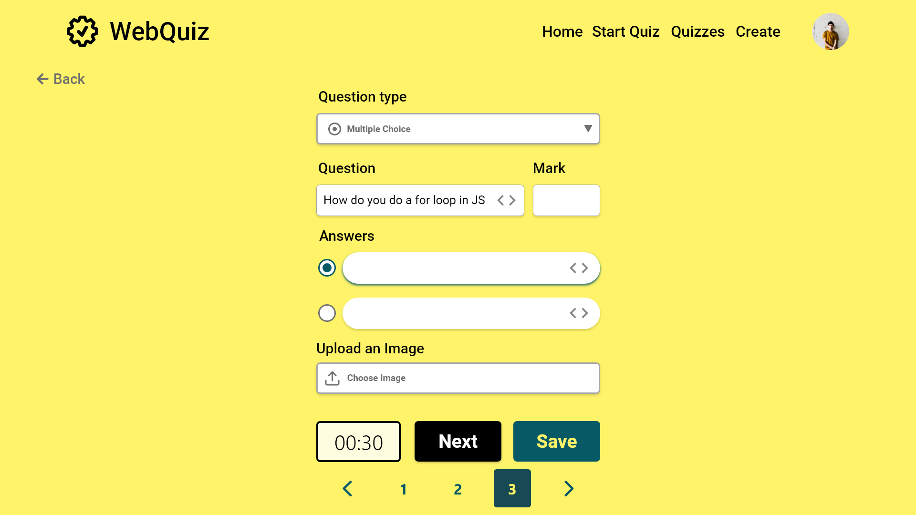

Slide 47


Slide 48
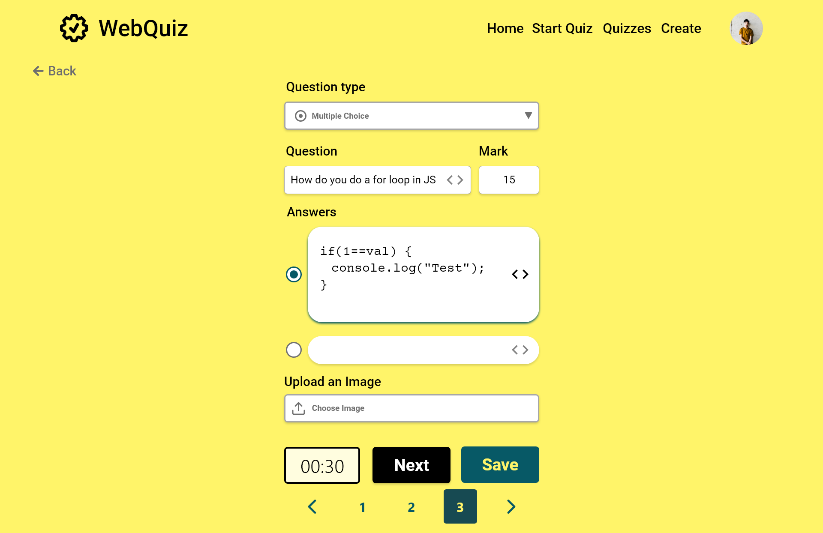

Slide 49
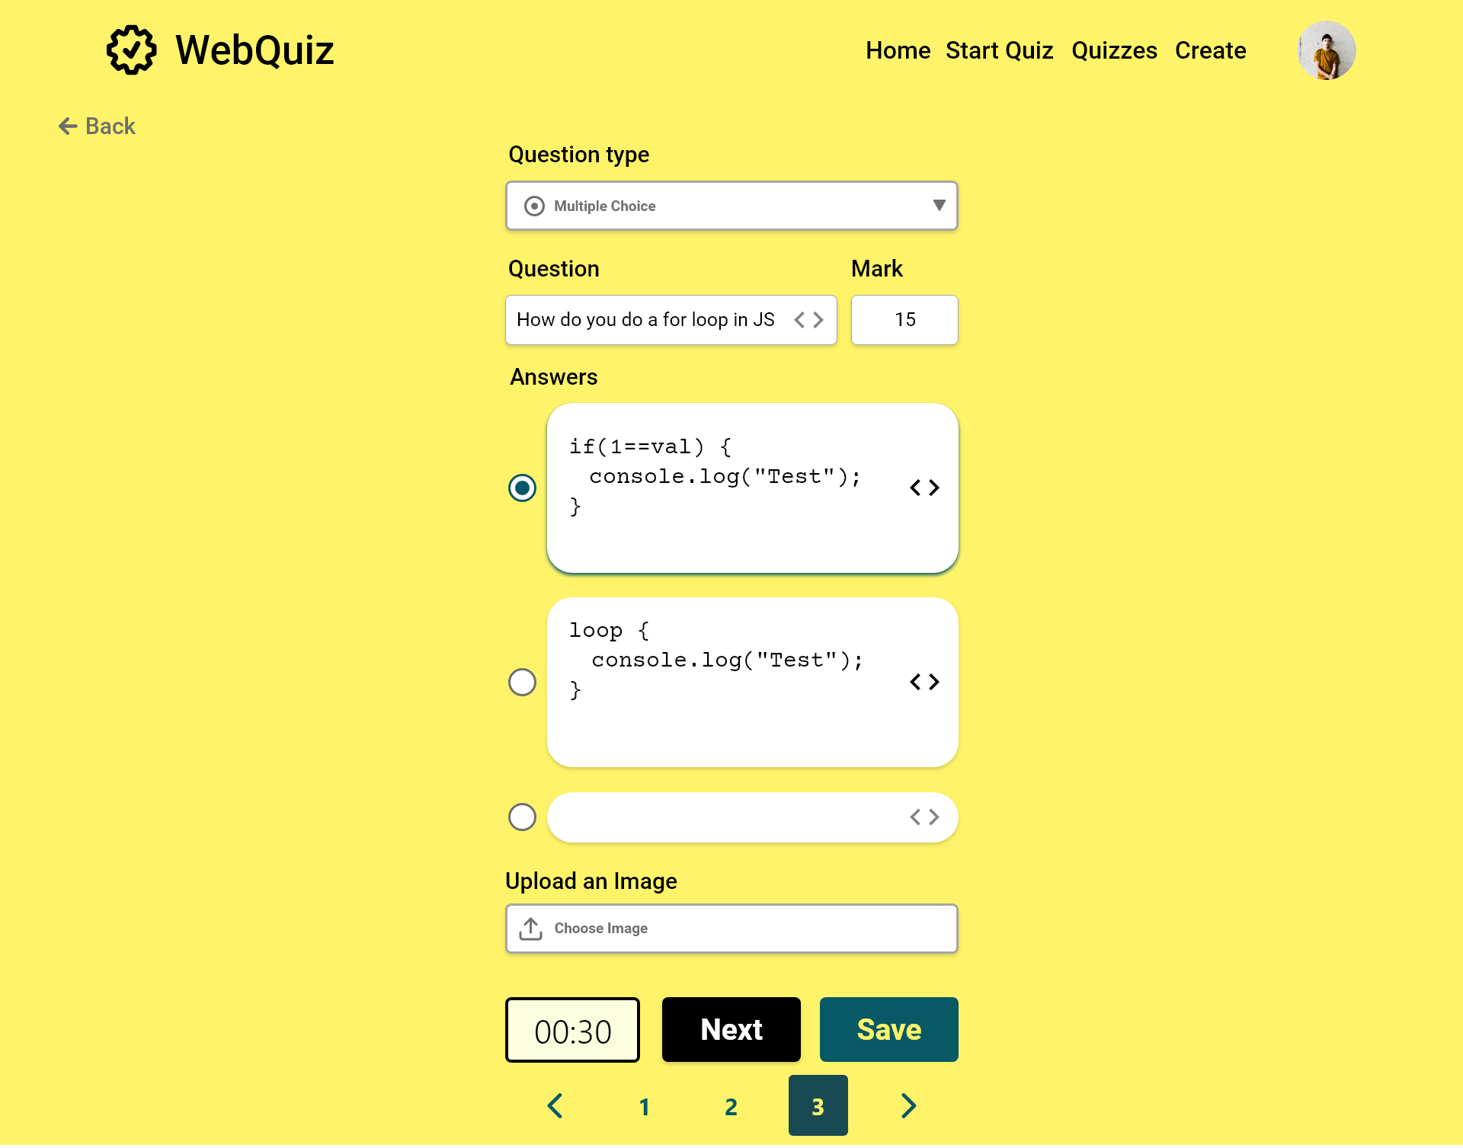

Slide 50
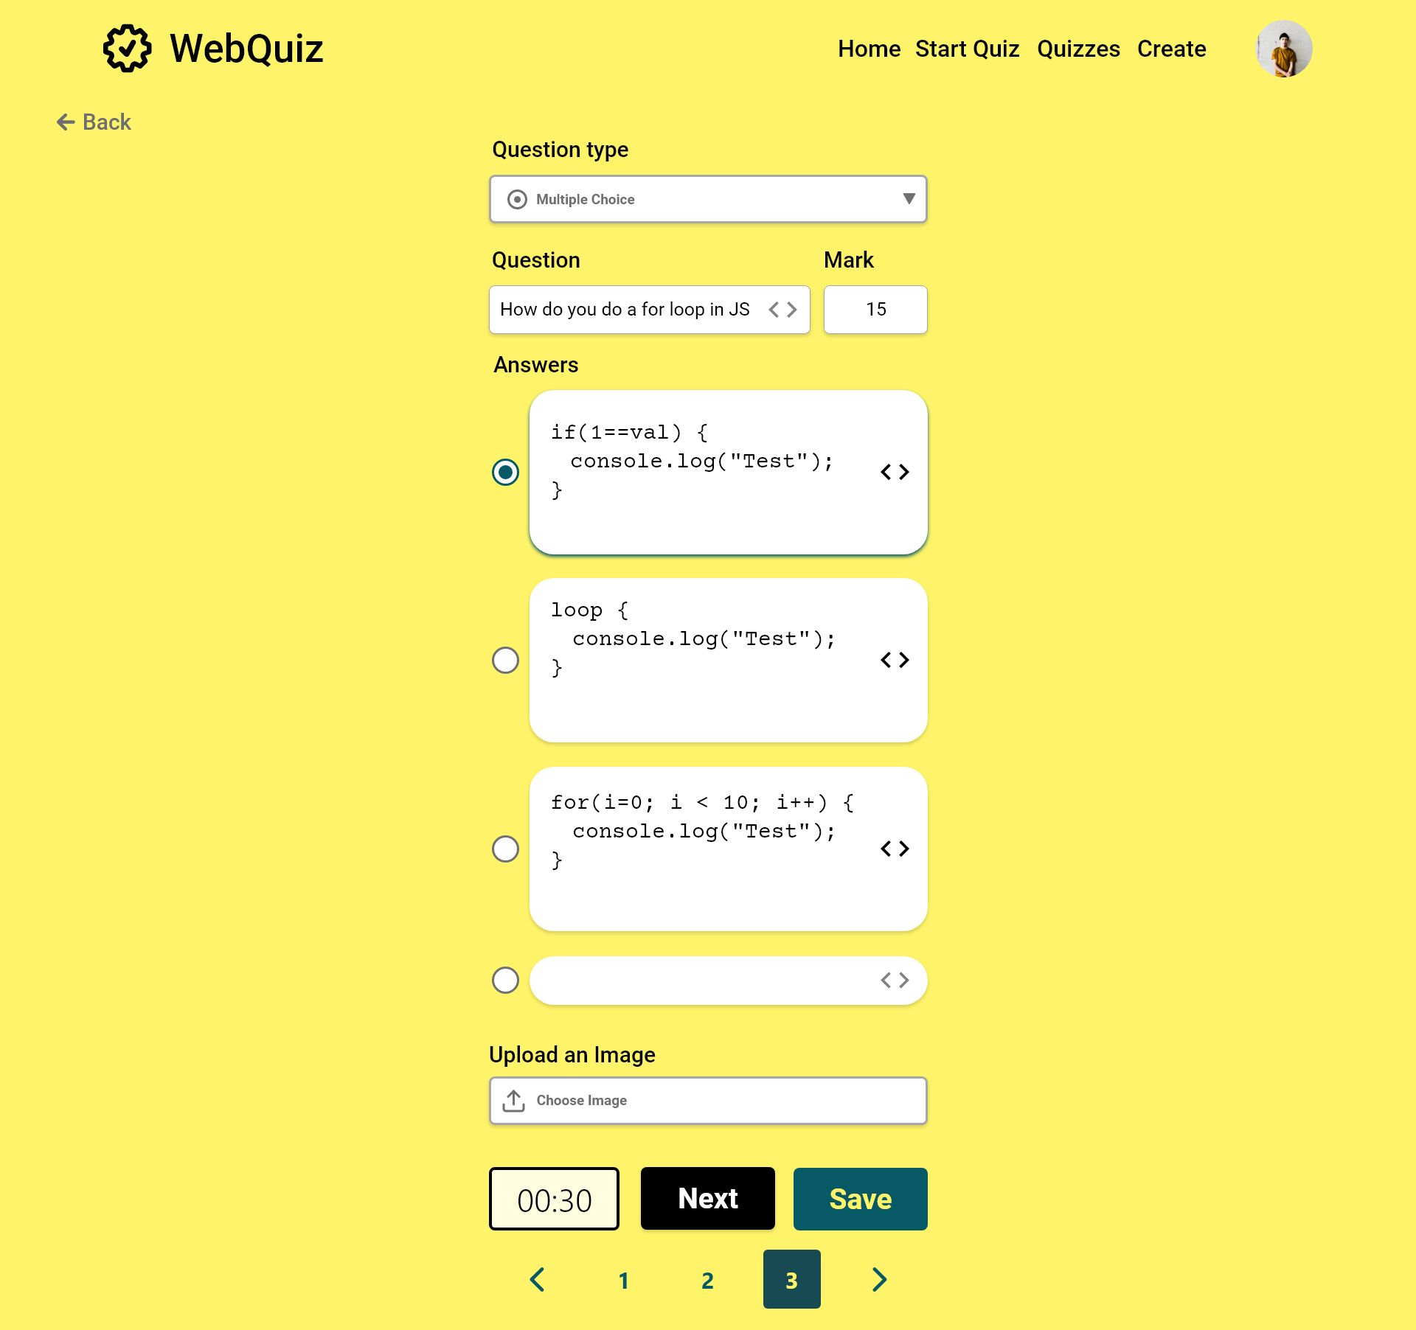

Slide 51
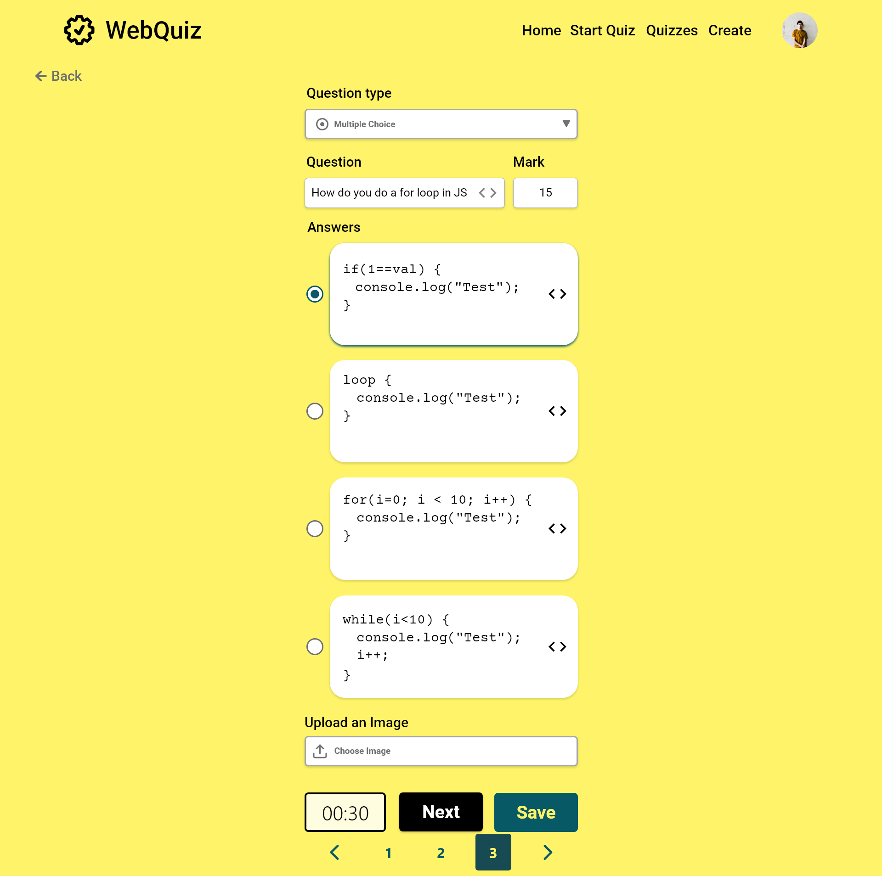

Slide 52


Slide 53
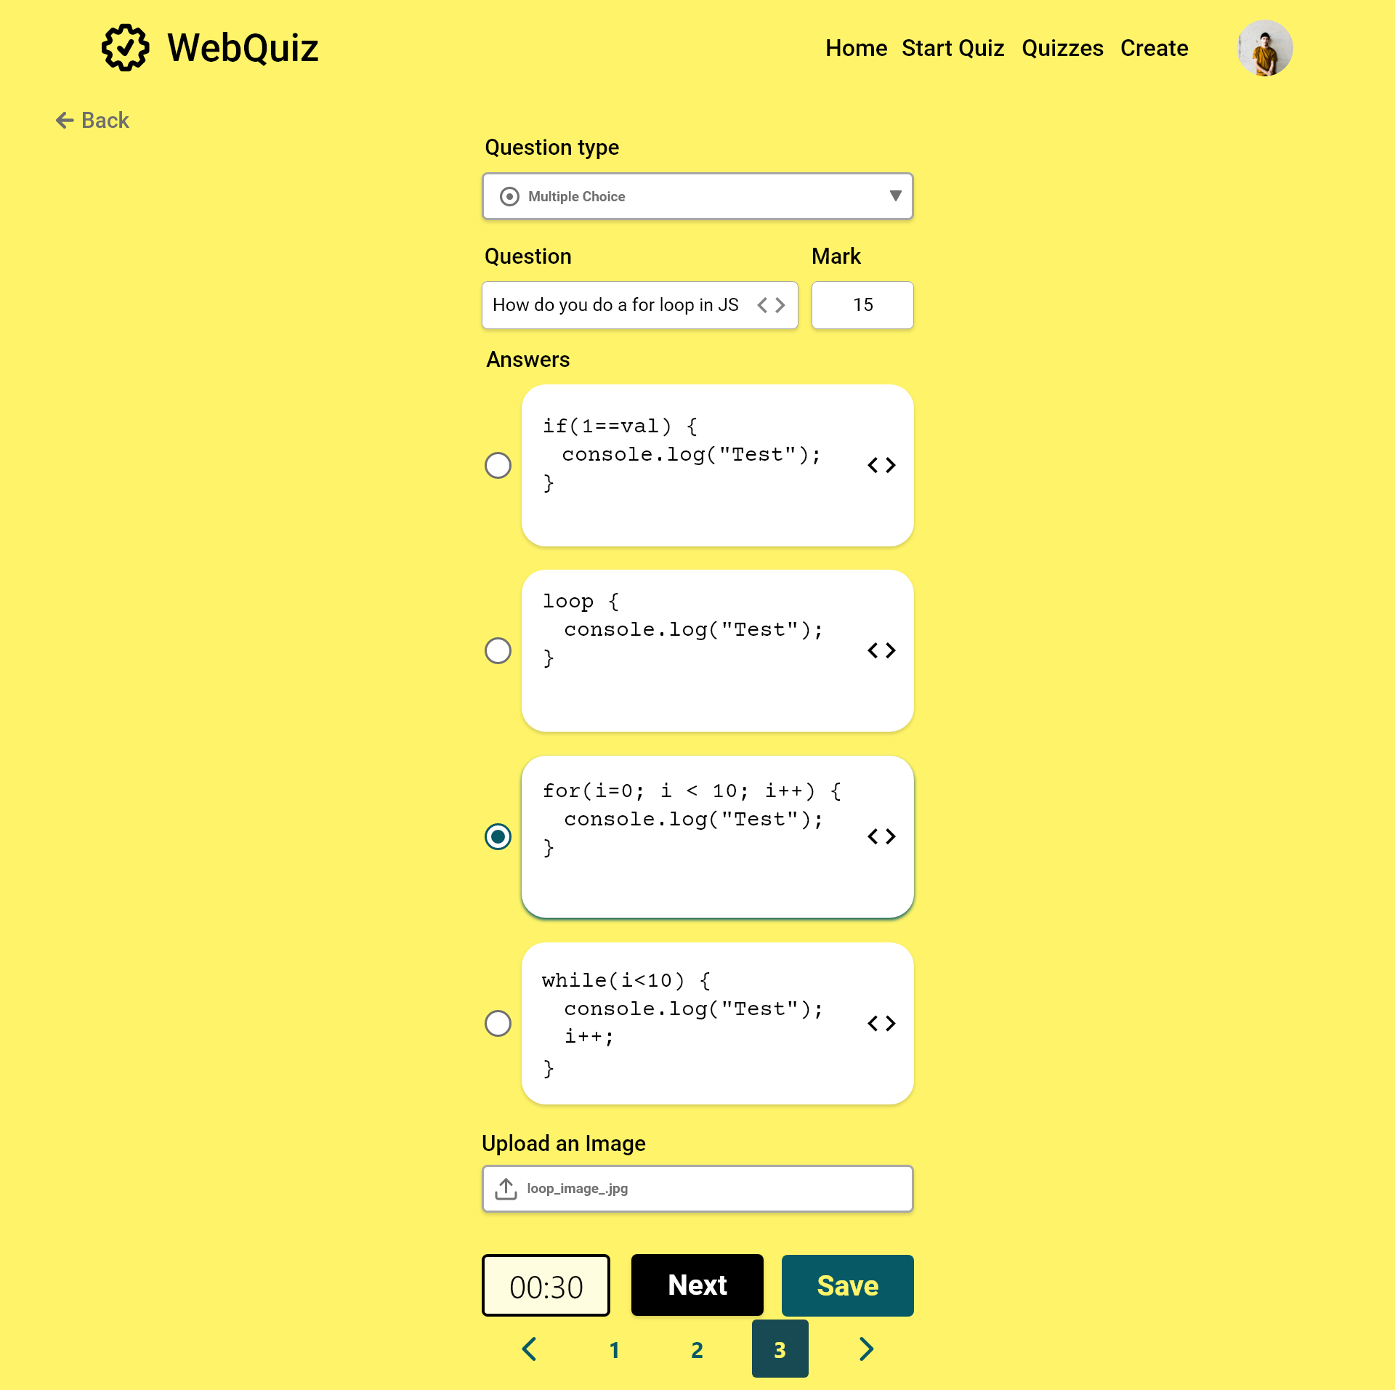

Slide 54
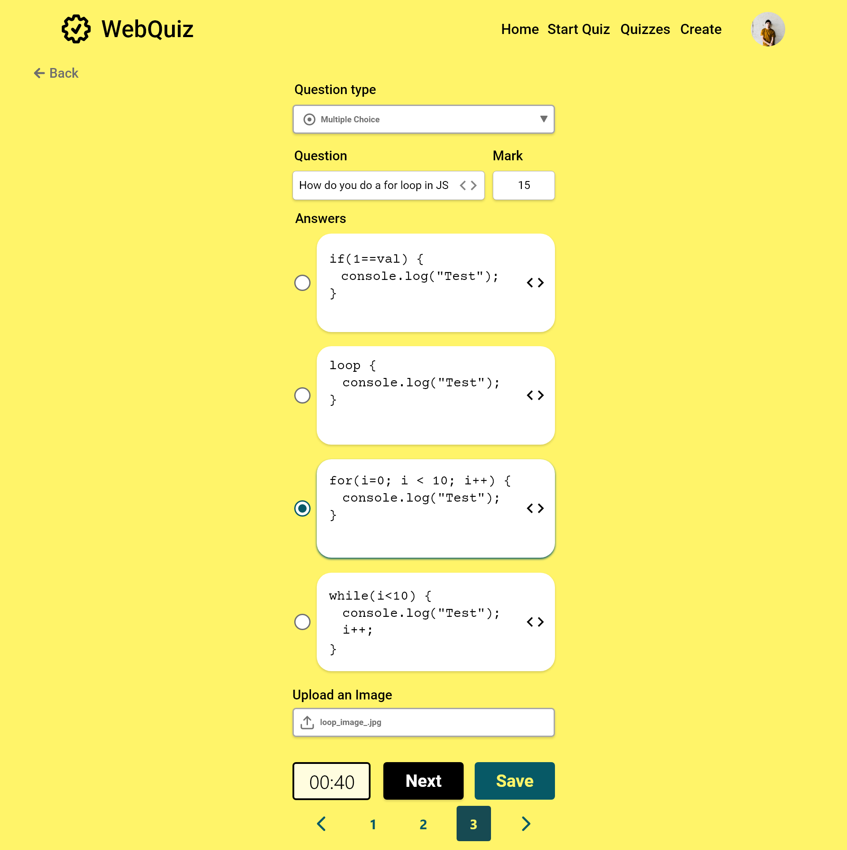

Slide 55
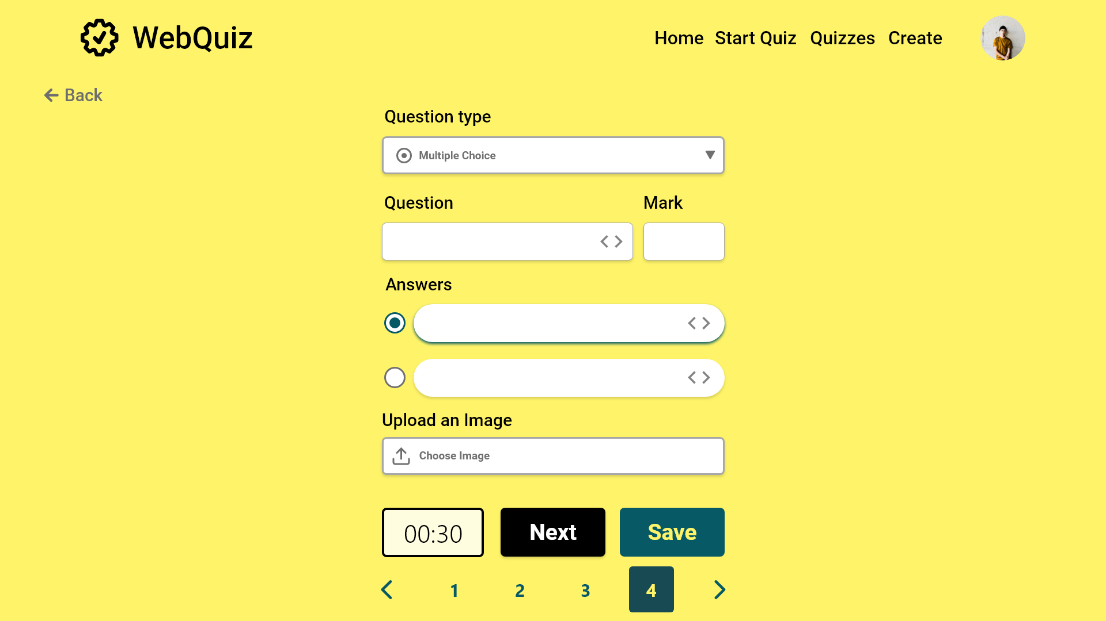

Slide 56
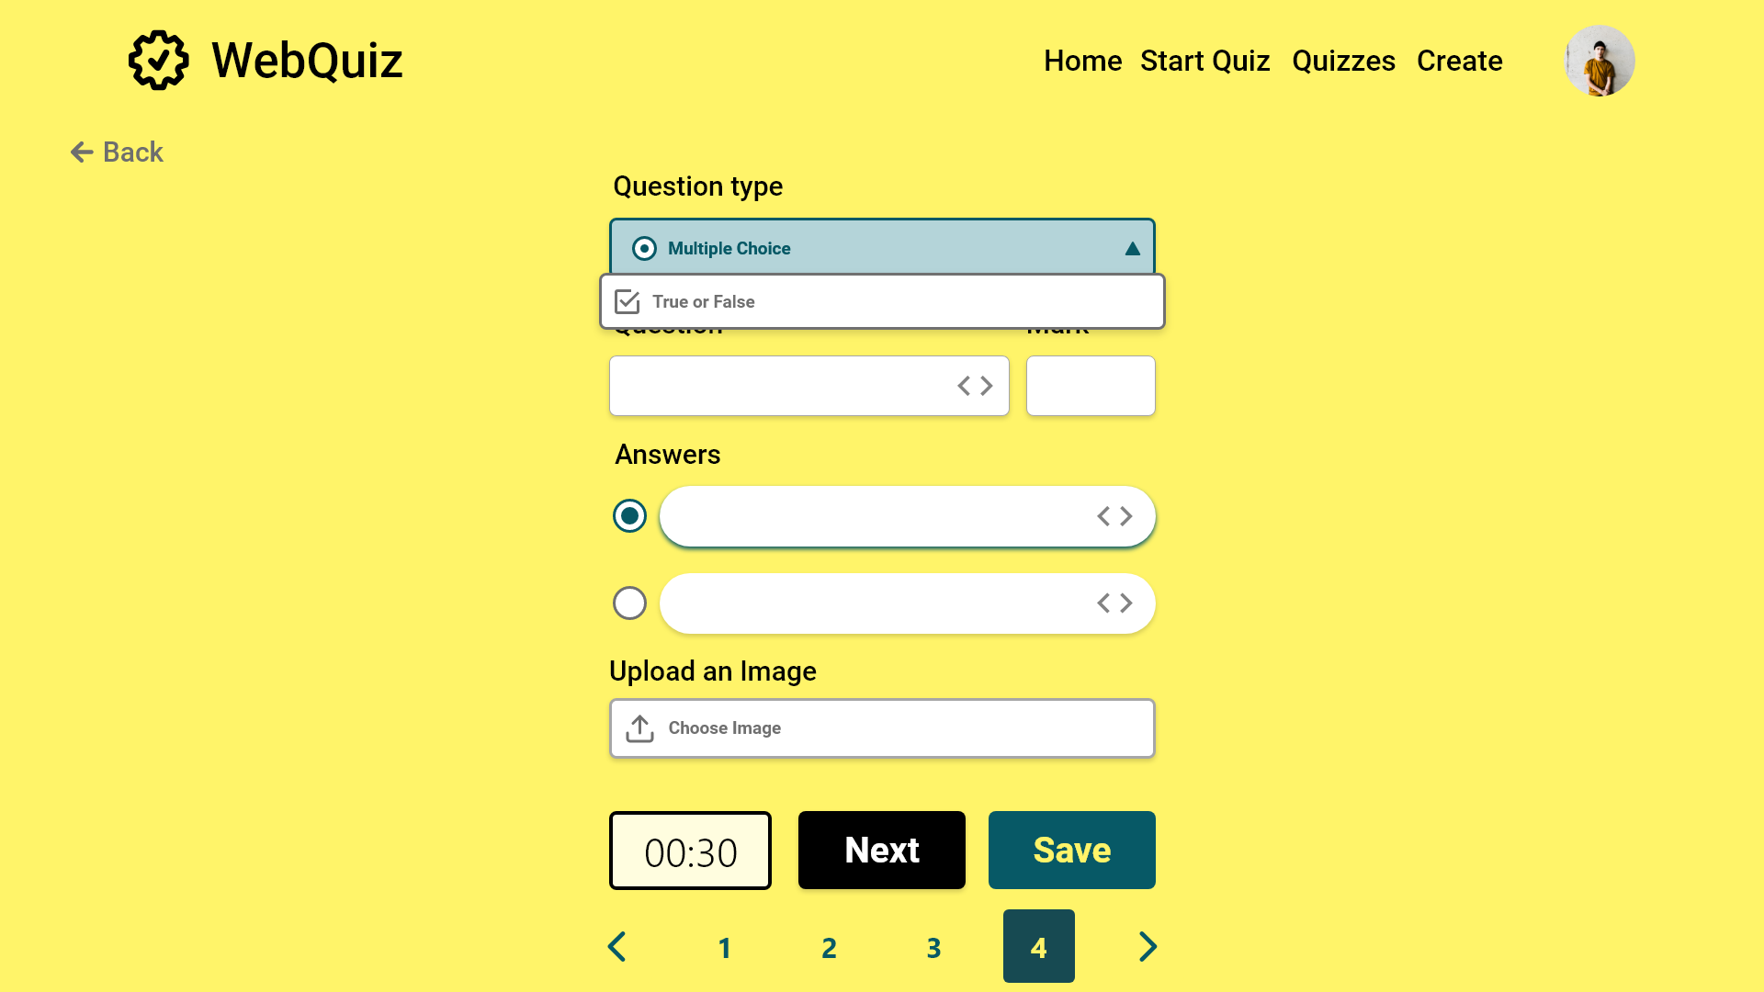

Slide 57
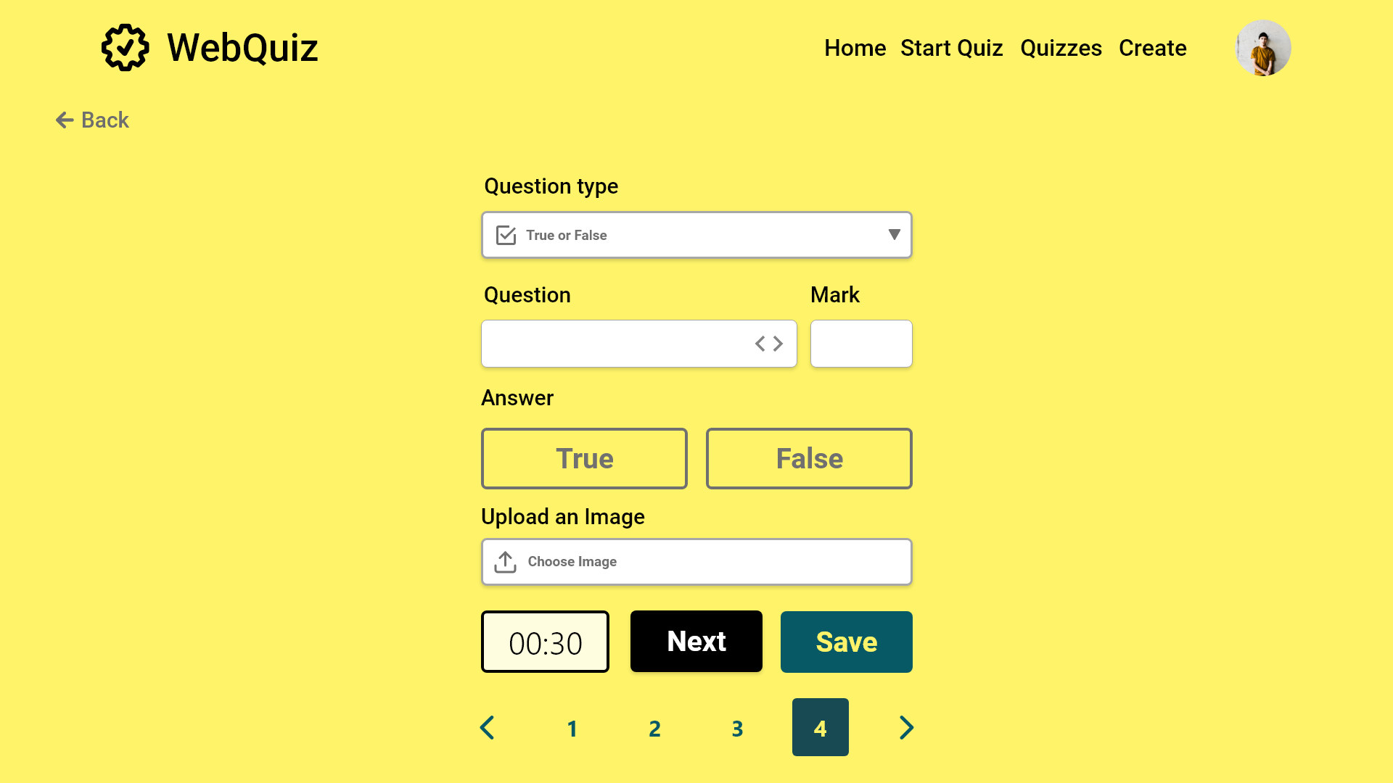

Slide 58


Slide 59


Slide 60
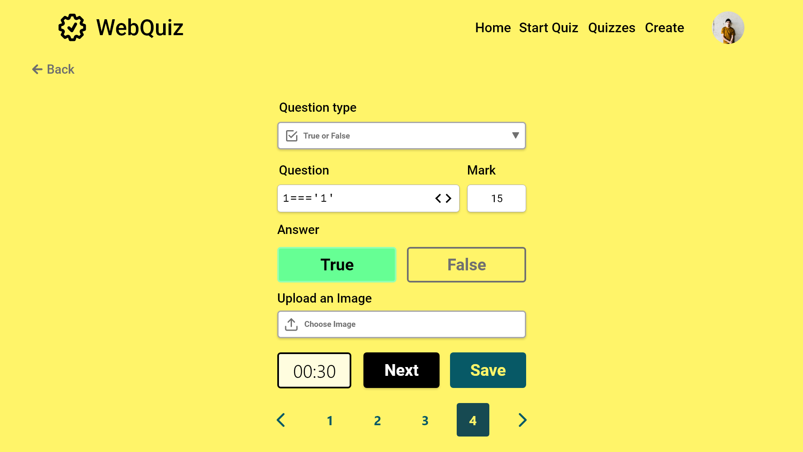

Slide 61
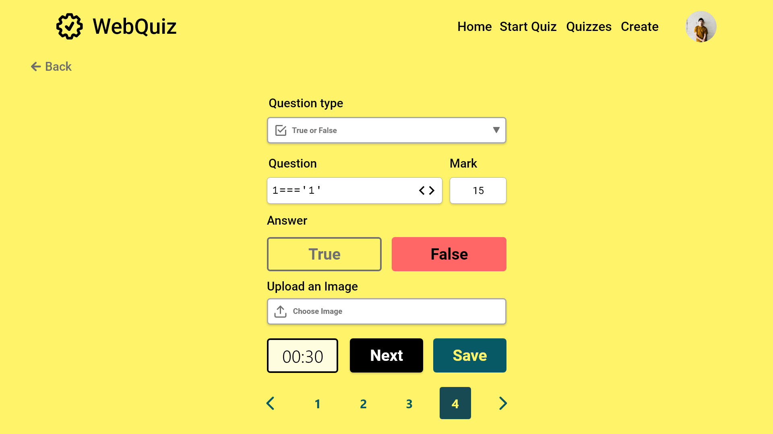

Slide 62


Slide 63


Slide 64
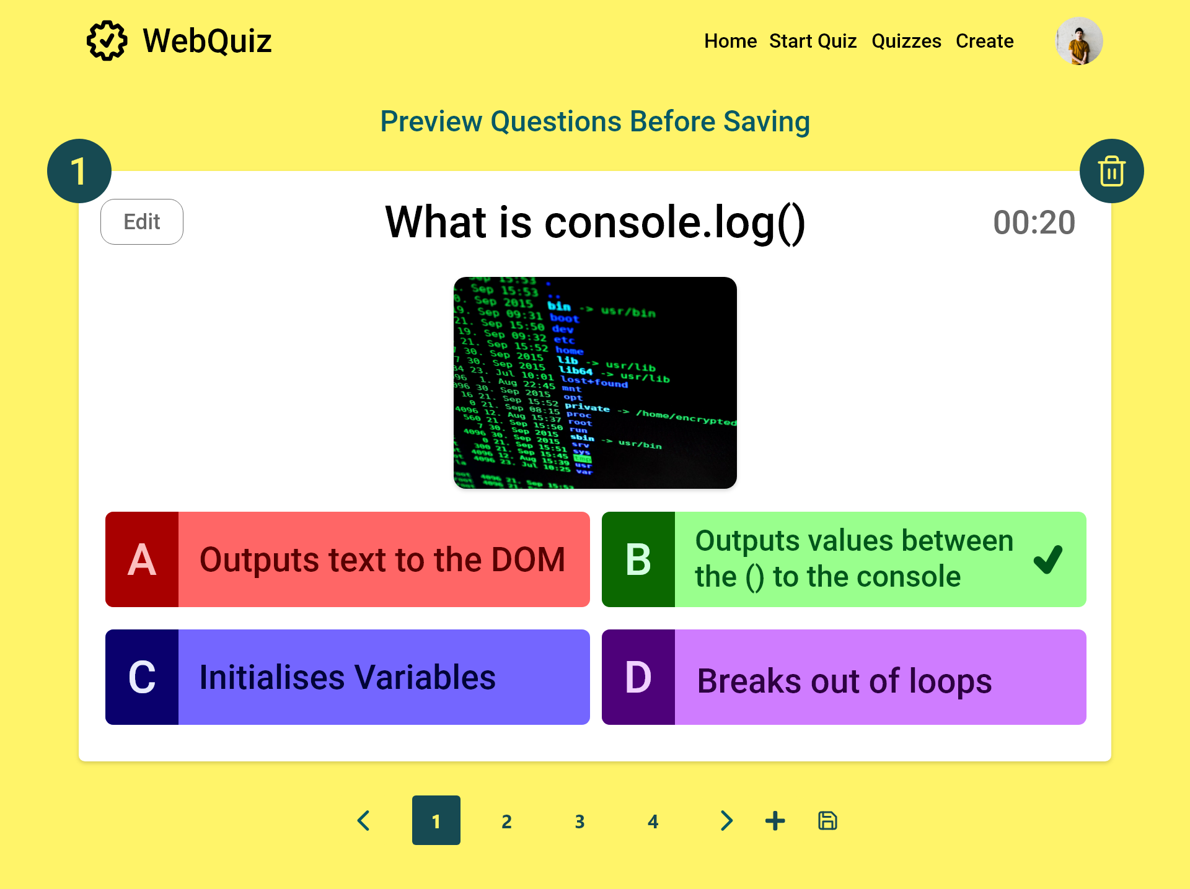
Delete Question
Edit Question
Add question
Save

Slide 65
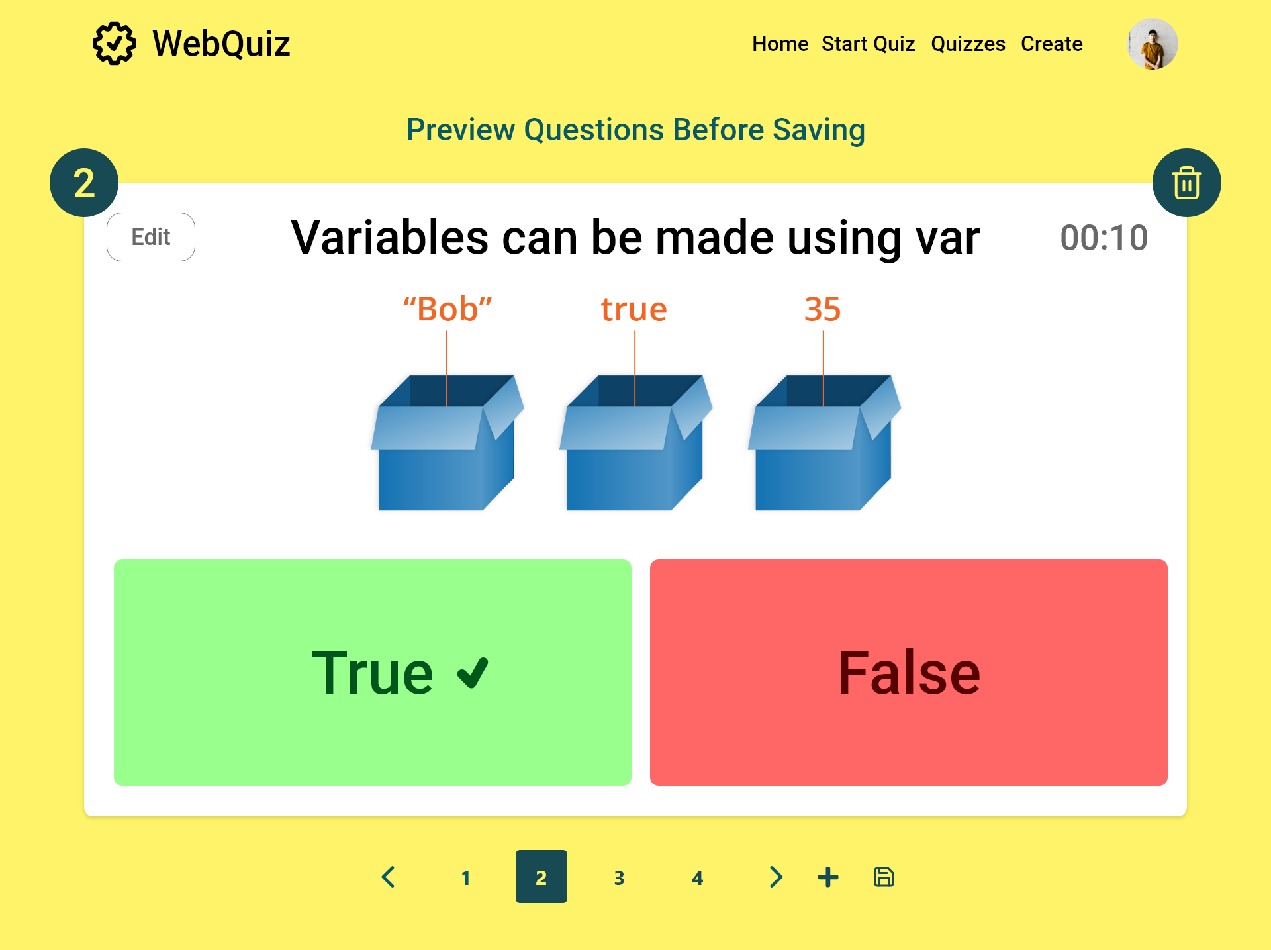

Slide 66
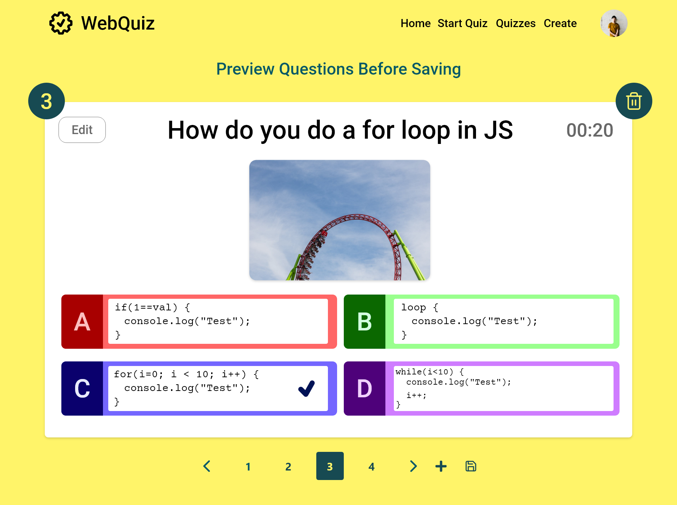

Slide 67


Slide 68

Undo Delete

Slide 69
Quizzes

Slide 70


Slide 71


Slide 72


Slide 73


Slide 74


Slide 75


Slide 76


Slide 77


Slide 78
Start Quiz Menu

Slide 79


Slide 80
Start Quiz

Slide 81

Turn off timer
Start quiz
Change between
participant and Quiz Master

Slide 82

Turn on timer
Start quiz
Change between
participant and Quiz Master

Slide 83

Change between
participant and Quiz Master

Slide 84
Question 1

Slide 85

Change between
participant and Quiz Master

Slide 86

Change between
participant and Quiz Master

Slide 87
Participant view Question 1

Slide 88

Change between
participant and Quiz Master

Slide 89

Change between
participant and Quiz Master

Slide 90

Change between
participant and Quiz Master

Slide 91

Change between
participant and Quiz Master

Slide 92
Question 2

Slide 93

Case where need to end quiz early
Change between
participant and Quiz Master

Slide 94

Case where need to end quiz early
Change between
participant and Quiz Master

Slide 95
Participant view Question 2

Slide 96

Change between
participant and Quiz Master

Slide 97

Change between
participant and Quiz Master

Slide 98

Change between
participant and Quiz Master

Slide 99

Change between
participant and Quiz Master

Slide 100
Question 3

Slide 101

Change between
participant and Quiz Master

Slide 102
Change between
participant and Quiz Master

Slide 103
Participant view Question 3

Slide 104

Change between
participant and Quiz Master

Slide 105

Change between
participant and Quiz Master

Slide 106

Change between
participant and Quiz Master

Slide 107

Change between
participant and Quiz Master

Slide 108
Question 4

Slide 109

Change between
participant and Quiz Master

Slide 110

Change between
participant and Quiz Master

Slide 111
Participant view Question 4

Slide 112

Change between
participant and Quiz Master

Slide 113

Change between
participant and Quiz Master

Slide 114

Change between
participant and Quiz Master

Slide 115

Change between
participant and Quiz Master

Slide 116
Results

Slide 117


Slide 118


Slide 119


